Slide 1

9618 AS-Level
Unit 1
Information Representation

Slide 2
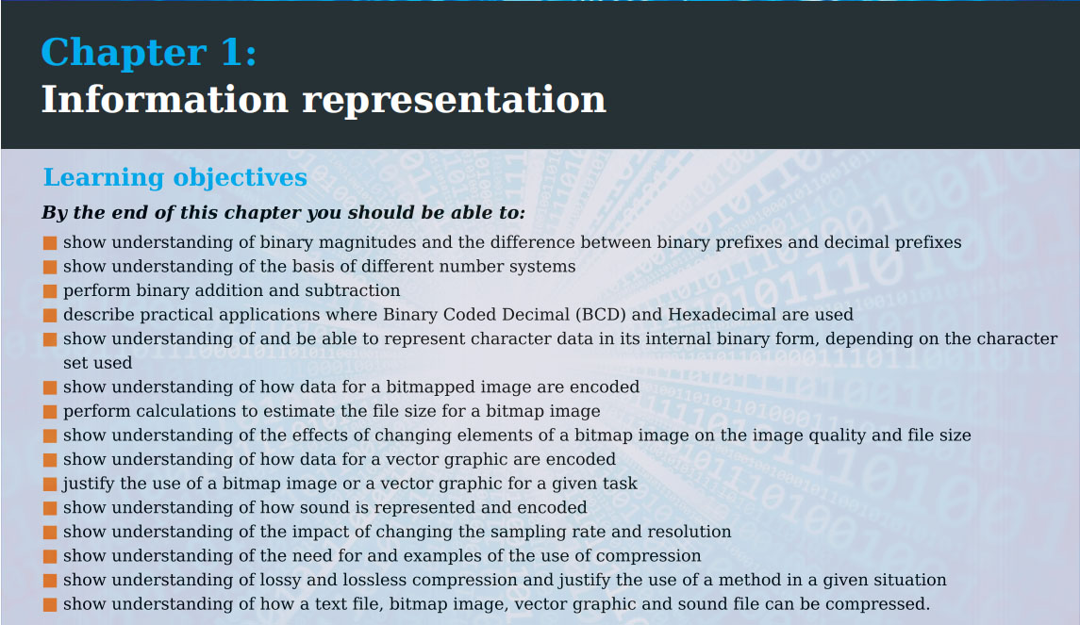

Slide 3
Number Systems

Slide 4
Class Overview
Binary & denary number systems
Converting between them
Use cases of binary, denary, hexadecimal etc
Bits, bytes, nibbles
Formula for max/range of number we can represent in an unsigned (positive) number system
Most & least significant bits
Number of bits required to represent a number

Slide 5
Number Systems
Do you know what the “base” of a number system is? Do you know what base number system we use?
The base of a number system is the number of different digits available
Hence we use base-10 (0-9) – also known as the denary/decimal system

Slide 6
Number Systems
Do you know what number system a computer/most digital devices use?
Binary – i.e. base-2

Slide 7
Number Systems
What do you think is stored in binary in a computer?
Answer: everything
Numbers, text (strings), video, audio, programs etc – it’s all encoded as 1’s and 0’s – actually a computer has no concept of the number 2 or letter ‘A’ at all

Slide 8
Number Systems
A 1 value can be considered on/true
Hence a 0 can be considered off/false

Slide 9
Denary/Decimal/Base-10
?
?
← | 10⁴ | 10³ | 10² | 10¹ | 10⁰ | 10⁻¹ | 10⁻² | 10⁻³ | →
 | 10,000 | 1,000 | 100 | 10 | 1 | 0.1 | 0.01 | 0.001
?
?
?
?
?
So, what do you think the number 936 actually means in base-10?
(9 x 100) + (3 x 10) + (6 x 1)

Slide 10
Binary/Base-2
?
?
?
← | 2⁴ | 2³ | 2² | 2¹ | 2⁰ | 2⁻¹ | 2⁻² | 2⁻³ | →
x2 | 16 | 8 | 4 | 2 | 1 | 0.5 | 0.25 | 0.125 | /2
?
?
?
?
What do you think the position values for binary will be?
Note: fractional (fixed-point or floating-point) binary is not required for AS – that will be for A2
Note how going left = multiplying by 2 (doubling), while going right = dividing by 2 (halving)

Slide 11
Digits and Bits
Do you know what a “bit” is in binary?
It stands for binary digit
So digits are individual numbers in a denary number – i.e. 9, 3 and 6 in the denary number 936
…while bits are the individual numbers in a binary number – e.g. 1, 0, 0, 1 in the binary number 1001

Slide 12
Binary/Base-2
?
?
?
?
?
?
?
2¹³ | 2¹² | 2¹¹ | 2¹⁰ | 2⁹ | 2⁸ | 2⁷ | 2⁶ | 2⁵ | 2⁴ | 2³ | 2² | 2¹ | 2⁰
8192 | 4096 | 2048 | 1024 | 512 | 256 | 128 | 64 | 32 | 16 | 8 | 4 | 2 | 1
?
?
?
?
?
?
What are the first 14 positive binary positional values?
Sometimes exams will feature numbers comprised of 14 bits – though usually they will use up to 8
Do you know the significance of 8 bits?
8 bits = 1 byte

Slide 13
Bits, Nibbles and Bytes
Bit = 1 binary digit – e.g. 1
Nibble = 4 bits – e.g. 0110
Byte = 10110001
Do you know what the word “nibble” means in daily use?
A small bite – e.g. you could say “a mouse nibbles on cheese” – so you can remember it as nibble = small bite (byte)

Slide 14
Calculating Denary Numbers
If you have the denary number 8492, it can be thought of as each digit multiplied by the denary positional value – i.e.
(8 * 10³) + (4 * 10²) + (9 * 10¹) + (2 * 10⁰)

Slide 15
Calculating Binary Numbers
Likewise, we use the same approach to calculate the bits in a binary number – let’s see…

Slide 16
Calculating Binary Numbers
2³ | 2² | 2¹ | 2⁰
8 | 4 | 2 | 1
1 | 0 | 0 | 1
Can you see how this is the same as in denary?
i.e. (1 * 8) + (0 * 4) + (0 * 2) + (1 * 1)
How could you simplify this?
Anything multiplied by 0 is 0 and anything multiplied by 1 is itself – so we can simplify to: 8 + 1

Slide 17
Binary vs Other Bases
We have said binary is base-2, while denary is base-10 – from the words, can you guess what base octal and hexadecimal would be?
Octal = base-8 (rarely used)
Hexadecimal = base-16 (very common – colours, IPv6, MAC and memory addresses etc)
Base-64 is also commonly used in computing – in converting raw binary to (ASCII) text and vice-versa
You can also easily create your own base, if you have a purpose (e.g. generating random IDs, encoding/encryption etc)

Slide 18
Binary vs Other Bases
Spreadsheet programs like WPS spreadsheet or Microsoft Excel actually use base-26 – do you know where?
The columns – note how the order is A, B, C…X, Y, Z, AA, AB, AC etc

Slide 19
Binary vs Other Bases
In other bases, we are required to multiply – e.g. 845 in denary is
(8 * 100) + (4 * 10) + (5 * 1)
This would get more complex with e.g. hexadecimal (base-16), base-64 or some arbitrary base – like base 9
In contrast, in binary, because we are going to multiply by either 0 or 1, we are simply able to add the bit values together (since n * 1 = n and n * 0 = 0)

Slide 20
Binary to Denary Practice
2³ | 2² | 2¹ | 2⁰
8 | 4 | 2 | 1
1 | 1 | 0 | 1
2³ | 2² | 2¹ | 2⁰
8 | 4 | 2 | 1
0 | 1 | 1 | 0
2³ | 2² | 2¹ | 2⁰
8 | 4 | 2 | 1
1 | 1 | 1 | 1
13
6
15

Slide 21
Binary to Denary Practice
2⁷ | 2⁶ | 2⁵ | 2⁴ | 2³ | 2² | 2¹ | 2⁰
128 | 64 | 32 | 16 | 8 | 4 | 2 | 1
1 | 1 | 0 | 1 | 1 | 1 | 0 | 1
221

Slide 22
Binary to Denary Practice
2⁷ | 2⁶ | 2⁵ | 2⁴ | 2³ | 2² | 2¹ | 2⁰
128 | 64 | 32 | 16 | 8 | 4 | 2 | 1
1 | 1 | 1 | 1 | 1 | 1 | 1 | 1
255

Slide 23
Maximum Number with N-Bits in Binary
Recap: bit = 1 binary digit
Do you remember how many bits are in a nibble and how many are in a byte?
Nibble = 4 bits; Byte = 8 bits
Question: what is the maximum number we can store in a nibble & byte respectively?
Nibble max = 15 (8 + 4 + 2 + 1)
Byte max = 255 (128 + 64 + 32 + 16 + 8 + 4 + 2 + 1)

Slide 24
Maximum Number with N-Bits in Binary
So we can store up to 15 in denary using 4 bits and up to 255 using 8 bits.
Can you think of a formula that will calculate the maximum denary number we can represent with n-bits?
2^{n} – 1
Verify this works with n = 4, n = 8
Hence, what is the maximum number we can store in 2 bytes?
2¹⁶ - 1 = 65535

Slide 25
Maximum Number with N-Digits in Other Bases
Do you think a similar equation to 2^{n} – 1 would work for denary?
Yes: 10^{n} – 1
This is even more intuitive – i.e. with 1 digit, the maximum is 9, with 2 digits, the maximum is 99, with 3 digits, the maximum is 999 and so on
So what would the general formula be?
b^{n} – 1
Where ‘b’ is the base and n is the number of digits/bits

Slide 26
Maximum Number Question
For example, if an exam asked to calculate the highest number that could be represented with 20 hexadecimal digits, what would the answer be?
16²⁰ – 1 = 1,208,925,819,614,629,174,706,175

Slide 27
Binary: Range of Numbers
Recap: if we have 4 bits, what is the maximum number can represent?
15
So with 4 bits (a nibble), what is the range of numbers we can represent?
0-15
Hence how many different numbers can we represent?
16
Can you think of generalized/binary-specific formula to calculate all of these features?

Slide 28
Maximum, Range & Number of Unique Values - Formulas
Number of Unique Values:
2^{n}
Maximum:
2^{n} – 1
Range:
0 to 2^{n} – 1
Again, these formulas work for any base – just change the 2 to the new base
Question: why do the maximum/range formulae contain the “-1”?
Since one of the numbers is zero – this is the same in denary – i.e. with 2 digits, the maximum number is 99 (i.e. 10² – 1)

Slide 29
Denary to Binary
We have seen how to go from binary to denary, now let’s see how to do the reverse

Slide 30
Denary to Binary
Let’s convert the denary number 9 into binary:
Informally: add up values until we reach our target number
We start from the left – if our target number is greater than or equal to the denary positional value, set the bit to 1 – if it’s smaller, set it to 0
If we set the bit to 1, subtract the denary positional value from the target number
2³ | 2² | 2¹ | 2⁰
8 | 4 | 2 | 1
1 | 0 | 0 | 1
9 >= 8: set to 1
t = 9 – 8 = 1
1 < 4: set to 0
1 < 2: set to 0
1 >= 1: set to 1

Slide 31
Denary to Binary: Practice
7
9
13
2³ | 2² | 2¹ | 2⁰
8 | 4 | 2 | 1
0 | 1 | 1 | 1
2³ | 2² | 2¹ | 2⁰
8 | 4 | 2 | 1
1 | 0 | 0 | 1
2³ | 2² | 2¹ | 2⁰
8 | 4 | 2 | 1
1 | 1 | 0 | 1

Slide 32
Denary to Binary: Counting
0 | 0000
1 | 0001
2 | 0010
3 | 0011
4 | 0100
5 | 0101
6 | 0110
7 | 0111
8 | 1000
9 | 1001
10 | 1010
11 | 1011
12 | 1100
13 | 1101
14 | 1110
15 | 1111
In later units – particularly logic circuits – you will need to list all the different input combinations
The simplest way to do this is simply to count in binary
Task: write all the combinations of 4 bits by counting in binary (what number will you need to count to?)

Slide 33
Denary to Binary: Counting
0 | 0000
1 | 0001
2 | 0010
3 | 0011
4 | 0100
5 | 0101
6 | 0110
7 | 0111
8 | 1000
9 | 1001
10 | 1010
11 | 1011
12 | 1100
13 | 1101
14 | 1110
15 | 1111
You might be slow at first, but you will get quicker – can you see any patterns?
e.g. if you set a left bit to a 1, all the bits to the right become 0 – i.e. 7 = 0111 → 8 = 1000

Slide 34
Denary to Binary
Let’s try some more difficult denary to binary conversions

Slide 35
Denary to Binary: Practice
37
2⁷ | 2⁶ | 2⁵ | 2⁴ | 2³ | 2² | 2¹ | 2⁰
128 | 64 | 32 | 16 | 8 | 4 | 2 | 1
0 | 0 | 1 | 0 | 0 | 1 | 0 | 1
?

Slide 36
Denary to Binary: Practice
148
2⁷ | 2⁶ | 2⁵ | 2⁴ | 2³ | 2² | 2¹ | 2⁰
128 | 64 | 32 | 16 | 8 | 4 | 2 | 1
1 | 0 | 0 | 1 | 0 | 1 | 0 | 0
?

Slide 37
Denary to Binary: Practice
239
2⁷ | 2⁶ | 2⁵ | 2⁴ | 2³ | 2² | 2¹ | 2⁰
128 | 64 | 32 | 16 | 8 | 4 | 2 | 1
1 | 1 | 1 | 0 | 1 | 1 | 1 | 1
?
What would be the maximum value we can represent with 8 bits? How could we use this to check our answer?
255 – so here we know that 239 is 16 less than 255 – hence we want all bits to be true, except for 16, which should be false

Slide 38
Most & Least Significant Bits
Two terms that are sometimes mentioned are the most & least significant bits (MSB & LSB)
The MSB is the bit with the highest value (i.e. the leftmost), while the LSB is the bit with the lowest value (i.e. the rightmost)
8 | 7 | 6 | 5 | 4 | 3 | 2 | 1
2⁷ | 2⁶ | 2⁵ | 2⁴ | 2³ | 2² | 2¹ | 2⁰
128 | 64 | 32 | 16 | 8 | 4 | 2 | 1

Slide 39
Most & Least Significant Bits
Here, bit 8 is the MSB and bit 1 is the LSB
Note that we usually count from right to left (i.e. in ascending order)
8 | 7 | 6 | 5 | 4 | 3 | 2 | 1
2⁷ | 2⁶ | 2⁵ | 2⁴ | 2³ | 2² | 2¹ | 2⁰
128 | 64 | 32 | 16 | 8 | 4 | 2 | 1

Slide 40
Removing Leading Zeros
Take the denary number 3 in binary – with 1 byte, it would be:
0000 0011
The leading zeros in this case are meaningless – for unsigned (positive) binary values, we can simply write the denary number 3 as 11 – would be 011 if using signed
If we want to represent the denary number 129, how many bits would we need? Let’s see how to calculate it…

Slide 41
Calculating Required Number of Bits
Do you know how we could calculate the required number of bits we need to represent a denary number – ‘n’?
Number of bits required: ⌈ log₂n ⌉
The ⌈ ⌉ symbols mean the ceiling function – i.e. round up – e.g.
⌈ 3.0001 ⌉ = 4

Slide 42
Calculating Required Number of Bits
So, how many bits would we need to represent the denary number 129?
answer = ⌈ log₂n ⌉ = ⌈ log₂129 ⌉ = ⌈ 7.011 ⌉ = 8

Slide 43
Calculating Required Number of Bits
Remembering the formula is good – since you could easily calculate the number of bits required to represent a huge number – like the number of atoms in the universe – in binary
For small numbers, you can intuitively think of it as “if the target number is greater than the current binary positional value, but less than the next, then we need this number of bits”
Let’s see an example…

Slide 44
Calculating Required Number of Bits
Rule: “if the target number is greater than the current binary positional value, but less than the next, then we need this number of bits”
8 | 7 | 6 | 5 | 4 | 3 | 2 | 1
2⁷ | 2⁶ | 2⁵ | 2⁴ | 2³ | 2² | 2¹ | 2⁰
128 | 64 | 32 | 16 | 8 | 4 | 2 | 1
How many bits are required to represent 56?
6 – since 56 > 32 AND 56 < 64
How about 127 & 128?
127: 7 bits;
128 = 8 bits

Slide 45
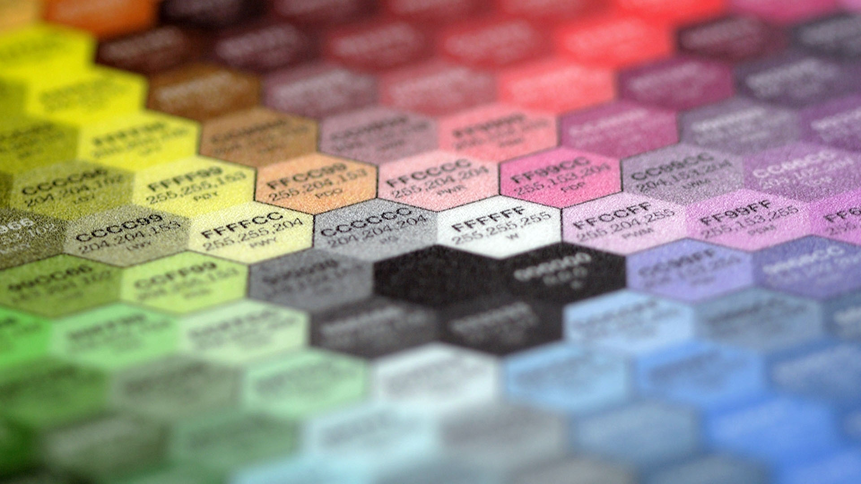
9618 AS
Computer Science
Hexadecimal

Slide 46
Class Overview
Hexadecimal number system & uses
Converting denary <-> hex
Converting binary <-> hex

Slide 47
Hexadecimal
0 | 0
1 | 1
2 | 2
3 | 3
4 | 4
5 | 5
6 | 6
7 | 7
8 | 8
9 | 9
A | 10
B | 11
C | 12
D | 13
E | 14
F | 15
Can you remember what base we said hexadecimal is?
Base-16
The first 10 hex digits are easy – simply the number 0-9
The next six are the letters A-F
So an example hex value could be ABC

Slide 48
Hexadecimal
Would 99 be a valid hex value?
Yes – since it’s in the range 0-F
This is why it’s important to specify what base is used – since 99 would be a valid denary, hexadecimal, base-64 (or actually an infinite number of different base) value – yet the actual value it represents would be different
We can specify with subscripts: 99₁₆

Slide 49
Hexadecimal
Would 4G6 be a valid hex value?
No – since G isn’t in the range 0-F

Slide 50
Hexadecimal
Do you know any uses of hex numbers – e.g. do you recognize #FF0000?
This would be the RGB hex colour value for red (#FF0000). Other uses include IPv6, MAC & memory addresses

Slide 51
Hexadecimal
Question: do you think a computer actually stores hexadecimal numbers internally?
No – it only stores binary – hexadecimal is just something humans can use, since it’s easier for us to understand
e.g. 5F9A is shorter & easier to understand than 0101111110011010

Slide 52
Hexadecimal
Using the same approach as we have used with binary and denary, do you know how we could calculate the denary value of the hexadecimal digits 99?
(9 * 16¹) + (9 * 16⁰) = 153

Slide 53
Hexadecimal
16⁵ | 16⁴ | 16³ | 16² | 16¹ | 16⁰
1,048,576 | 65,536 | 4,096 | 256 | 16 | 1
Do you recognise any of these numbers?
They also appeared in the binary → denary table
Do you know why base-2 and base-16 are related?
Because 2 can be multiplied by itself to make 16 – i.e. 2⁴ = 16
Likewise, base-3 and base-9 would share place values too

Slide 54
Hexadecimal
16⁵ | 16⁴ | 16³ | 16² | 16¹ | 16⁰
1,048,576 | 65,536 | 4,096 | 256 | 16 | 1
2²⁰ | 2¹⁶ | 2¹² | 2⁸ | 2⁴ | 2⁰
What is the relationship between the hexadecimal powers vs the binary powers for the same denary value?
The binary value is multiplied by 4 – this is because 2⁴ = 16

Slide 55
Hexadecimal
16⁵ | 16⁴ | 16³ | 16² | 16¹ | 16⁰
1,048,576 | 65,536 | 4,096 | 256 | 16 | 1
2²⁰ | 2¹⁶ | 2¹² | 2⁸ | 2⁴ | 2⁰
Do you know a power rule in maths that proves this relationship?
(a^{m})^{n} = a^{mn}
i.e. 16 = 2⁴, hence 16⁴ = (2⁴)⁴ = 2¹⁶

Slide 56
Hexadecimal
As a result of this relationship between base-2, we will see that converting from binary to hexadecimal and vice-versa is relatively easy
First though, let’s practice using the same method as before to convert some hexadecimal numbers to denary

Slide 57
Hexadecimal to Denary: Practice
32
FF
ABCD
16³ | 16² | 16¹ | 16⁰
4096 | 256 | 16 | 1
0 | 0 | 3 | 2
 |  | 48 | 2
16³ | 16² | 16¹ | 16⁰
4096 | 256 | 16 | 1
0 | 0 | F | F
 |  | 240 | 15
16³ | 16² | 16¹ | 16⁰
4096 | 256 | 16 | 1
A | B | C | D
40960 | 2816 | 192 | 13
?
?
?
50
255
43981

Slide 58
Denary to Hexadecimal
Again, we can use the same approach as we used converting denary to binary, but just in base-16…

Slide 59
Denary to Hexadecimal
Let’s convert the denary number 28 into hexadecimal:
We need 2 hex digits to represent this:
28 / 16¹ = 1 remainder 12
12 / 16⁰ = 12 = C
Answer = 1C

Slide 60
Denary to Hexadecimal: Practice
45
247
12345
16³ | 16² | 16¹ | 16⁰
4096 | 256 | 16 | 1
0 | 0 | 2 | D
16³ | 16² | 16¹ | 16⁰
4096 | 256 | 16 | 1
0 | 0 | F | 7
16³ | 16² | 16¹ | 16⁰
4096 | 256 | 16 | 1
3 | 0 | 3 | 9
?
?
?
2D
F7
3039

Slide 61
Hexadecimal to Binary & Vice-Versa
0 | 0000
1 | 0001
2 | 0010
3 | 0011
4 | 0100
5 | 0101
6 | 0110
7 | 0111
8 | 1000
9 | 1001
A | 1010
B | 1011
C | 1100
D | 1101
E | 1110
F | 1111
Converting between hexadecimal and binary is simpler than converting between hex and denary – this is because of the relationship between 2 and 16 (i.e. 2⁴ = 16)
What this means is that 1 hex digit = 4 bits

Slide 62
Hexadecimal to Binary & Vice-Versa
0 | 0000
1 | 0001
2 | 0010
3 | 0011
4 | 0100
5 | 0101
6 | 0110
7 | 0111
8 | 1000
9 | 1001
A | 1010
B | 1011
C | 1100
D | 1101
E | 1110
F | 1111
For example, if we have the hex value A47E, that would simply be:
1010 0100 0111 1110
Likewise, we can easily reverse the process when going from binary to hex

Slide 63
Hexadecimal to Binary: Practice
74B
DEAD
8391C
0111 0100 1011
1101 1110 1010 1101
1000 0011 1001 0001 1100

Slide 64
Binary to Hexadecimal: Practice
1111 0000 0000 1101
1100 1010 1111 1110
1010 0001
F00D
CAFE
A1

Slide 65
Task
Write some random numbers:
2 1 byte binary numbers
2 2 digit hex number
2 denary numbers between 0 and 255
Give these numbers to a classmate...

Slide 66
Task
Convert 1 binary number to denary & the other to hex
Convert 1 hex number to denary & the other to binary
Convert 1 denary number to binary and the other to hex
Use a website like https://www.mathsisfun.com/binary-decimal-hexadecimal-converter.html to verify your answers are correct

Slide 67
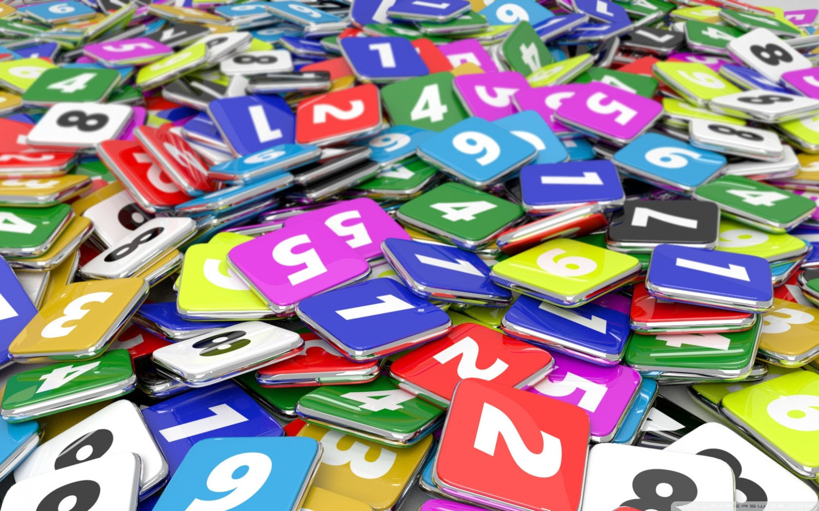
9618 AS
Unit 1
Numbers and Quantities

Slide 68
Class Overview
Numbers: integers and reals/floats
Signed & unsigned
Prefixes: Kilo, Mega, Giga, Tera
Prefixes: Kibi, Mebi, Gibi, Tebi
Converting between them

Slide 69
Types of Numbers in a Computer
There are various types of number that can be stored in a computer
The reason for these different data types of due to efficiency – i.e. wanting to store as much relevant information in as few bits as possible
For example, if we want to store a variable called NumberOfStudents, there is no point wasting some bits in memory to store a decimal point – it will be an integer (whole number) and relatively small

Slide 70
Integers
Have you heard the word “integer” used in maths? Do you know what it means?
A whole number – e.g. 3 is an integer, but 3.1 isn’t
Integers come in two forms – unsigned and signed.
Sign refers to the plus or minus sign – i.e. +/-
So an unsigned integer could be 3 (i.e. positive)
While a signed integer could be +3 or -3

Slide 71
Integers
So:
unsigned integers = positive only
signed integers = positive or negative
Note: the plus or minus value isn’t actually stored in the computer – the most significant bit in a signed integer is negative
We’ll see how signed integers work later

Slide 72
Fractions
Although fractions like ½ are common in maths, they are not used (commonly) in computers
Instead, computers simply use reals/floats (decimals) – i.e. 0.5
It would, however, be possible to create a representation of fractions in a programming language, if you had a need to do so (e.g. for higher precision or creating educational software that demonstrated fractions)

Slide 73
Decimals – Reals/Floats
In computer science, decimals are called reals or floats (short for “floating point”)
Examples: 3.14, 1.60, -4.75
For AS, you aren’t required to know how they are represented in binary – however you do need to know the name of the data type – i.e. REAL in pseudocode

Slide 74
Scientific/Standard Notation - Floats
As you know from maths/physics, we can represent a number like 300,000,000 as 3x10⁸
This is called a floating-point number – since the decimal point (or with binary, binary point) can ‘float’ left or right, depending on the magnitude of the number
As mentioned, floats also support non-integer numbers – that’s because 16 x 10⁻²⁰ can be written as 1.6 x 10⁻¹⁹

Slide 75
Quantities
In maths/science, rather than saying 10,000 meters, we could simply say 10km
What does the “k” mean?
Kilo = 1000
Let’s recall some of the others

Slide 76
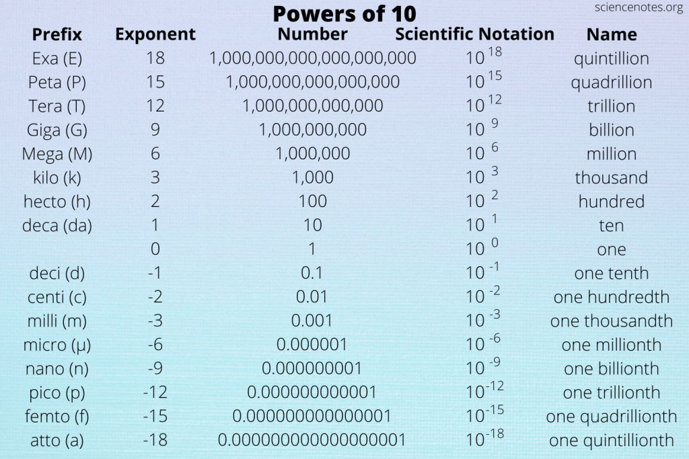

Slide 77
Quantities
For computer science, these are the ones to remember:
Name | Prefix | Power of 10 | Value
Tera | T | x10¹² | 1,000,000,000,000
Giga | G | x10⁹ | 1,000,000,000
Mega | M | x10⁶ | 1,000,000
Kilo | K | x10³ | 1,000
Note that “K” is sometimes written in lowercase – e.g. km

Slide 78
Quantities
So, how many bytes are in 1 kilobyte, megabyte, gigabyte and terabyte?
1,000 1,000,000 1,000,000,000 1,000,000,000,000
How many bits are in 1 megabyte?
8,000,000
How many bytes are in 1 gigabit?
125,000,000

Slide 79
Quantities
Note: a lower case b = bits; upper case B = bytes
So MB = megabytes, while Mb = megabits
When you bought your monthly phone package, what unit was likely used and why?
Most likely Mb – since the number will be bigger…e.g…

Slide 80
Quantities
Imagine phone company A offers 20Gb of data at a speed of 2Mb per second. Now imagine company B offers 3GB at 0.5MB/s.
Which company would the average person choose?
Probably A – since the numbers seem bigger
Which company actually offers a better deal?
B – in bits, they offer 24Gb of data at a transfer speed of 4Mb/s
Since 1 byte = 8 bits, to convert between one or the other, we either multiply or divide by 8

Slide 81
Questions
An .mp3 file is 18MB – how many bits is that?
(18 * 1,000,000) * 8 = 144,000,000b
An HD .mp4 movie averages 4Mb/s – how many gigabytes would a 2 hour movie use?
(4 * 60 * 60 * 2 * 1,000,000) / (1,000,000,000 * 8) = 3.6GB
Note: we could simplify the 1,000,000 / 1,000,000,000 to just be / 1000

Slide 82
Questions
Note: the exam is non-calculator, so would use simpler numbers that you can easily simplify – we will look at these questions in another video

Slide 83
Problem
For maths & science, they operate in base-10 – however for computers, they operate in base 2 – as such, some people would use alternate definitions – i.e.
1Ki = 1024 bytes (2¹⁰)
1Mi = 1,048,576 bytes (2²⁰)
1Gi = 1,073,741,824 bytes (2³⁰)
1Ti = 1,099,511,627,776 bytes (2⁴⁰)
Note how the powers increment by 10

Slide 84
Solution
Because of this 1024 vs 1000 confusion, a new set of units were introduced:
Name | Prefix | Power of 2 | Value
kibi | Ki | x2¹⁰ | 1,024
mebi | Mi | x2²⁰ | 1,048,576
gibi | Gi | x2³⁰ | 1,073,741,824
tebi | Ti | x2⁴⁰ | 1,099,511,627,776

Slide 85
Problem
Rather than previously saying 1 gibibytes = 1,073,741,824 bytes (which is confusing/difficult to understand/remember), we could instead consider things in terms of the previous group – i.e.
1 kibibyte = 1024 bytes
1 mebibyte = 1024 kibibytes (1024²)
1 gibibyte = 1024 mebibytes (1024³)
1 tebibyte = 1024 gibibytes (1024⁴) etc

Slide 86
Questions
You see a computer with a 16GiB of RAM and another with 16GB – how many bits does of RAM does each have?
16 * 2³⁰ * 8 = 137,438,953,472
16 * 10⁹ * 8 = 128,000,000,000

Slide 87
Questions
You want to download an 800MB file – the server can send at 10GB/s and you can receive at 5MiB/s – how long will the download take?
Convert 800MB to MiB = (800 * 1,000,000) / 2²⁰ = 762.939…
Prev answer / 5 = 153 seconds = 2 minutes 33 seconds
Note how the server speed here is irrelevant – we only care about the slower speed

Slide 88
Task
Find the storage size of your SSD/HDD, cache, remaining/used storage etc
Perform various conversion – e.g. if you have 752GiB worth of storage remaining on your HDD/SSD, how many TiB/b/MB etc is that
Use to check: https://ss64.com/convert.html

Slide 89
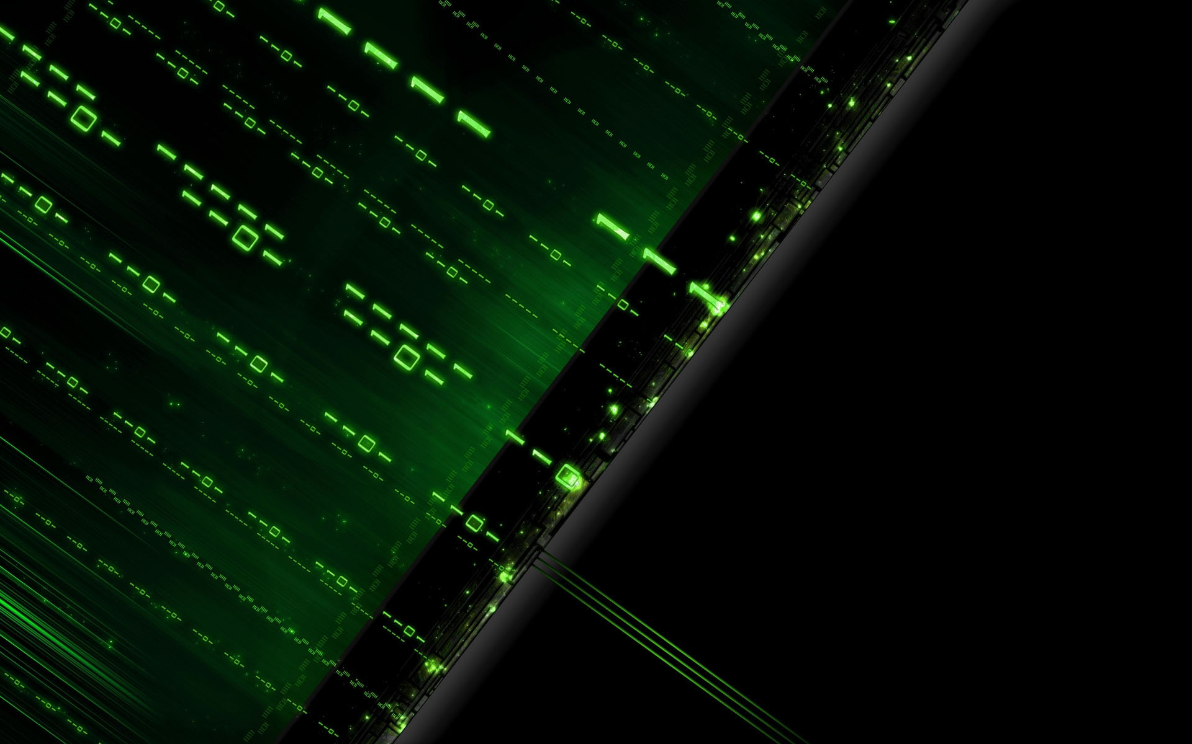
9618 AS
Unit 1
Internal Coding of Numbers

Slide 90
Class Overview
Representing negative binary numbers
Signed magnitude, one’s complement, two’s complement
Advantages/disadvantages of each

Slide 91
Internal Coding of Numbers
This chapter will focus on integers – chapter 16 in A2 will focus on floating/fixed point numbers

Slide 92
Signed vs Unsigned
We mentioned the terms “signed” and “unsigned” numbers (could be integers, reals/floats etc) – do you remember the difference?
Unsigned = no sign (+ or -), hence positive by default
Signed = positive or negative

Slide 93
Two’s Complement vs One’s Complement vs Signed Magnitude
Traditionally, there have been 3 different approaches to represent the sign of a number:
Signed magnitude
One’s complement
Two’s complement
The book mentions all 3 – these days, 99.99999% of devices use two’s complement

Slide 94
Signed magnitude
The simplest method for humans to understand – the most significant bit is simply the sign bit – 0 = positive; 1 = negative
For example, using 4 bits:
6 | 0 | 1 | 1 | 0
-6 | 1 | 1 | 1 | 0
Again:
0 is +
1 is -

Slide 95
Signed magnitude
What do the words “sign” and “magnitude” mean?
Sign is whether the number is positive or negative
Magnitude is the ‘size’ of the number – equivalent to the absolute value
i.e. the magnitude of 5 = |-5|
This is why it’s called “signed magnitude” – since it words by simply adding a sign in front of the magnitude (this is how we write numbers on paper too…though we omit the plus sign – i.e. we write +5 as simply 5)

Slide 96
Signed magnitude: questions
?
7 | 0 | 1 | 1 | 1
-7 | 1 | 1 | 1 | 1
?
79 | 0 | 1 | 0 | 0 | 1 | 1 | 1 | 1
-79 | 1 | 1 | 0 | 0 | 1 | 1 | 1 | 1
?
104 | 0 | 1 | 1 | 0 | 1 | 0 | 0 | 0
-104 | 1 | 1 | 1 | 0 | 1 | 0 | 0 | 0

Slide 97
Signed magnitude
Do you remember the biggest number we could represent with 8 bits using an unsigned representation?
2⁸ – 1 = 255
When dealing with 8-bit unsigned numbers, how many bits contributed to the magnitude? How many bits contribute for the magnitude in signed magnitude?
Unsigned = all 8 bits used for magnitude
Signed-magnitude: 7 bits used for magnitude (since 1 bit used for sign)

Slide 98
Signed magnitude
Hence, what would be the biggest and smallest (i.e. most negative) number with could represent with 8 bit signed magnitude
Biggest = 127 = 01111111
Smallest = -127 = 11111111
What would be a formula to represent the biggest/smallest numbers using n-bits for signed magnitude?
±2^{n-1} - 1

Slide 99
Signed magnitude
While it may seem like signed magnitude solves the problem of representing negative numbers, signed magnitude doesn’t work well for arithmetic – let’s try the calculation 5 + (-5) – what would we expect the answer to be in binary?
Carry | 1 |  | 1
5 | 0 | 1 | 0 | 1
-5 | 1 | 1 | 0 | 1
= | 0 | 0 | 1 | 0
Expected answer: 0 = 0000
Hence, arithmetic doesn’t work with signed magnitude…so we need a different approach…

Slide 100
Signed magnitude
Question: what do the numbers 0000 and 1000 represent?
+0 and -0 – it’s both wasteful and strange that there are 2 representations of zero
This is also one reason that causes arithmetic not to work correctly with signed magnitude
It is possible to design circuitry to correctly perform signed magnitude arithmetic – but it is complex, inefficient and more expensive than the best alternative (two’s complement)

Slide 101
One’s complement
We saw signed magnitude had 2 issues – another approach was developed to try to solve this
One’s complement simply means flipping/inverting/negating the bits to convert from positive to negative and vice-versa – for example:
5 = 0101
-5 = 1010
Note: there is no sign bit – all bits contribute to the magnitude

Slide 102
One’s complement: questions
?
3 | 0 | 0 | 1 | 1
-3 | 1 | 1 | 0 | 0
?
26 | 0 | 0 | 0 | 1 | 1 | 0 | 1 | 0
-26 | 1 | 1 | 1 | 0 | 0 | 1 | 0 | 1
?
107 | 0 | 1 | 1 | 0 | 1 | 0 | 1 | 1
-107 | 1 | 0 | 0 | 1 | 0 | 1 | 0 | 0

Slide 103
One’s Complement Arithmetic
While it may seem like one’s complement solves the problem of representing negative numbers, one’s complement also doesn’t work well for arithmetic – let’s try the calculation 5 + (-5) – what would we expect the answer to be in binary?
Carry
5 | 0 | 1 | 0 | 1
-5 | 1 | 0 | 1 | 0
= | 1 | 1 | 1 | 1
Expected answer: 0 = 0000
1111 is a strange answer…but technically not wrong in one’s complement

Slide 104
One’s Complement – Zero?
How would you represent 0 in one’s complement?
There are actually 2 ways – 0000 and 1111
i.e. a +0 and a -0 – again, this is redundant and is why the arithmetic doesn’t work
If you try some more additions in one’s complement, you’ll notice the answer is always 1 less than what it should be – i.e. something like 9 + -3 would equal 5, not 6
9 = 1001
-3 = 1100
answer = 0101

Slide 105
One’s complement
Decimal | Signed magnitude | 1’s compliment | 2’s compliment
7 | 0111 | 0111 | 0111
6 | 0110 | 0110 | 0110
5 | 0101 | 0101 | 0101
4 | 0100 | 0100 | 0100
3 | 0011 | 0011 | 0011
2 | 0010 | 0010 | 0010
1 | 0001 | 0001 | 0001
0 | 0000 | 0000 | 0000
-0 | 1000 | 1111
-1 | 1001 | 1110 | 1111
-2 | 1010 | 1101 | 1110
-3 | 1011 | 1100 | 1101
-4 | 1100 | 1011 | 1100
-5 | 1101 | 1010 | 1011
-6 | 1110 | 1001 | 1010
-7 | 1111 | 1000 | 1001
-8 |  |  | 1000
We said 1’s complement will result in an error by -1 for arithmetic
If you looks at 2’s compliment, the negative values are +1 compared to 1’s compliment – there is also only 1 zero and -8

Slide 106
Two’s Complement
Now we’ll look at two’s complement – this is what is actually used in 99.99999% of modern computers
This approach works by making the most significant bit negative – for example, with 4 bits, 5 and -5 would be represented as:
 | -8 | 4 | 2 | 1
5 | 0 | 1 | 0 | 1
-5 | 1 | 0 | 1 | 1
4 + 1 = 5
-8 + 2 + 1 = -5

Slide 107
Two’s Complement Arithmetic
Let’s again try 5 + -5 (i.e. 5 – 5), this time using the two’s complement representation
Carry | 1 | 1 | 1
5 | 0 | 1 | 0 | 1
-5 | 1 | 0 | 1 | 1
= | 0 | 0 | 0 | 0
As we can see, arithmetic with two’s complement works
Hence, this is what computers actually use

Slide 108
Two’s Complement
Suppose we want to represent -102 in two’s complement – what would the value of the most significant bit be/how many bits would we need?
-128 – so we need 8 bits
Our logic can be -128 + n = -102
n would be 26 – so we need the other 7 bits to add up to 26
 | -128 | 64 | 32 | 16 | 8 | 4 | 2 | 1
-102 | 1 | 0 | 0 | 1 | 1 | 0 | 1 | 0

Slide 109
Two’s Complement
 | -8 | 4 | 2 | 1
-7 | 1 | 0 | 0 | 1
?
 | -128 | 64 | 32 | 16 | 8 | 4 | 2 | 1
-35 | 1 | 1 | 0 | 1 | 1 | 1 | 0 | 1
?
 | -128 | 64 | 32 | 16 | 8 | 4 | 2 | 1
-76 | 1 | 0 | 1 | 1 | 0 | 1 | 0 | 0
?

Slide 110
Two’s Complement – Converting from Positive to Negative
To convert from a positive number – say 12 – to it’s negative equivalent – i.e. -12, we simply “flip the bits & add 1” – so remember this rule
When thinking about one’s compliment, do you know why we need to add 1 for two’s complement?
Since arithmetic answers in one’s compliment were always off by -1 – so if we add 1, the answer will be correct

Slide 111
Two’s Complement – Converting from Positive to Negative
Let’s try converting from 12 to -12 – how many bits do we need?
 | -16 | 8 | 4 | 2 | 1
12 | 0 | 1 | 1 | 0 | 0
Flip bits | 1 | 0 | 0 | 1 | 1
Now we need to add 1
Carry |  |  | 1 | 1
Flipped | 1 | 0 | 0 | 1 | 1
Add 1 | 0 | 0 | 0 | 0 | 1
= | 1 | 0 | 1 | 0 | 0
-16 + 4 = -12
so it’s correct

Slide 112
Two’s Complement – Converting from Positive to Negative
We have seen that 12 and -12 are 01010 and 10100 respectively when using 5 bits – what would they be if we used 8 bits?
0000 1010 and 1111 0100
Note how leading 0s for a positive number are redundant – but let’s check leading 1s for the negative value too
1111 0100 = -128 + 64 + 32 + 16 + 4 = -128 + 116 = -12

Slide 113
Two’s Complement – Converting from Positive to Negative
Hence, we can say:
Positive numbers: leading zeros have no effect:
011₂ = 000000011₂ = 3₁₀
Negative numbers: leading ones have no effect:
101₂ = 11111101₂ = -3₁₀

Slide 114
Two’s Complement – Converting from Positive to Negative
Using the “flip the bits & add 1” method, convert the following positive numbers to negative – answers should use 1 byte
17 → -17
48 → -48
90 → -90
-17 = 1110 1111
-48 = 1101 0000
-90 = 1010 0110

Slide 115
Two’s Complement – Converting from Positive to Negative
Do you think this ‘flip the bits & add 1’ method would work going from negative → positive?
Try it – convert 6 to -6 and back to 6
It does – so this method can be used to convert a two’s complement number from positive to negative and vice-versa

Slide 116
Two’s Complement – Converting from Positive to Negative
So far, there have been two methods to calculate the binary representation of a negative denary number in two’s complement
Do it directly – the most-significant bit is negative, the rest are positive
Take the positive binary two’s complement value, then ‘flip the bits & add 1’
There is also 1 other method you can use – sometimes this has been given as a programming task in the exam

Slide 117
Two’s Complement – Converting from Positive to Negative
Start from right & go left
Keep all bits the same, until & including the first ‘1’ you see
After the first ‘1’, then flip all remaining bits
This is actually just doing the same as the ‘flip the bits & add 1’ method, but it does it more directly
0110 = 6
1010 = -6
flip bits | first 1 | keep same

Slide 118
Two’s Complement – Converting from Positive to Negative
If we know the binary value, this method is very quick – again, it works from positive to negative and negative to positive
0111
10000001
11100000
00110000
1001
01111111
00100000
11010000

Slide 119
Note: sometimes students get confused and ALWAYS try to e.g. “flip the bits and add 1” – but you only have to do that if you want to convert from positive to negative or vice-versa
Two’s complement numbers can be positive OR negative…if a question asks you to “write 37 in two’s complement form”, then that will be positive – i.e. 00100101
“Write 37 as a binary/signed binary number” is also saying to use two’s complement – since it’s the default
If they say unsigned binary, however, it means the most significant bit will be positive

Slide 120

9618 AS
Unit 1
Binary Addition, Subtraction
& Overflow

Slide 121
Class Overview
Binary addition
Binary subtraction
Overflow
Calculating PI to 1 billion digits

Slide 122
Denary Addition
Before looking at binary addition, let’s first look at how we can add denary numbers
We can place each number in a row and add a carry row above

Slide 123
Denary Addition
Let’s try a few examples
Carry | 1 | 1
75 |  | 7 | 5
47 |  | 4 | 7
= | 1 | 2 | 2
Carry | 2 | 2
18 |  | 1 | 8
95 |  | 9 | 5
83 |  | 8 | 3
27 |  | 2 | 7
= | 2 | 2 | 3
?
?
?
?

Slide 124
Binary Addition
Luckily, we can use the same method with binary – the rules are:
0 + 0 = 0
0 + 1 = 1
1 + 1 = 0 & carry 1
1 + 1 + 1 = 1 & carry 1
Note: the properties are commutative – i.e. 1 + 0 = 0 + 1
Likewise, 1 + 1 + 0 = 0 + 1 + 1
1 + 1 would be like 3 + 7 in denary (i.e. that equals 10, so we would put a 0 in this digit’s column, then carry a 1 to the left)
1 + 1 + 1 would be like 4 + 7 (i.e. there’s a sum & carry)
Inputs |  |  | Sum | Carry
0 | 0 |  | 0 | 0
0 | 1 |  | 1 | 0
1 | 1 |  | 0 | 1
1 | 1 | 1 | 1 | 1

Slide 125
Binary Addition
Assume these are 4-bit unsigned binary integers
Carry |  | 1
 | 1 | 0 | 1 | 0
 | 0 | 0 | 1 | 1
= | 1 | 1 | 0 | 1
Carry | 1
 |  | 1 | 0 | 0 | 0
 |  | 1 | 1 | 0 | 0
= | 1 | 0 | 1 | 0 | 0
?
?
?
?
Since we said these are 4 bit binary integers and the answer requires 5 bits, this is called ‘overflow’ – i.e. we can’t correctly represent the real answer with the number of bits available
What would be the correct answer of this addition and what is the real answer represented?
Correct = 8 + 12 = 20 Yet, with 4 bits, we store 0100 = 4

Slide 126
Overflow
“If 2 Two's Complement numbers are added, and they both have the same sign (both positive or both negative), then overflow occurs if and only if the result has the opposite sign. Overflow never occurs when adding operands with different signs.”
Can you think of examples to demonstrate this? Try using 4 bits

Slide 127
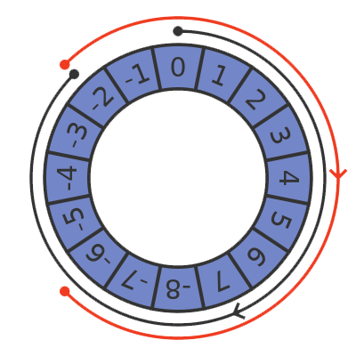
Overflow
What will happen if we perform the calculation 7 (0111) + 1 (0001)?
It will overflow to become -8 (1000)

Slide 128
“…they both have the same sign, then overflow occurs if and only if the result has the opposite sign…”
Carry | 1
 |  | 1 | 0 | 0 | 0
 |  | 1 | 0 | 0 | 0
= | 1 | 0 | 0 | 0 | 0
Carry | 1 | 1
 |  | 1 | 1 | 0 | 0
 |  | 1 | 1 | 0 | 0
= | 1 | 1 | 0 | 0 | 0
-8 + -8 = -16
out answer of 0000 is incorrect
i.e. operands have same sign (1), answer (0000) has different sign (0)
-4 + -4 = -8
our answer of 1000 is correct
i.e. operands & answer have same sign

Slide 129
“…they both have the same sign, then overflow occurs if and only if the result has the opposite sign…”
Do you know why this example works, even with the carry out?
Since for negative two’s complement, any leading 1s are redundant – i.e. 1000 = 11111000 = -8
Equivalently, leading 0s for positive numbers are redundant
Carry | 1 | 1
 |  | 1 | 1 | 0 | 0
 |  | 1 | 1 | 0 | 0
= | 1 | 1 | 0 | 0 | 0

Slide 130
“Overflow never occurs when adding operands with different signs”
This makes sense, since if we add numbers with opposite signs, the result will always get closer to 0, compared to the more extreme value
e.g.
7 + -1 = 6 (6 is closer to 0 than 7)
-8 + 1 = -7 (-7 is closer to 0 than -8)

Slide 131
Overflow
Does overflow also occur in denary?
Yes – if you said you are only allowed to use n digits
For example, you couldn’t represent the denary number 1000 using only 3 digits – the sum 999 + 1 wouldn’t yield the correct answer with only 3 digits

Slide 132
Overflow
Why can’t we just use an infinite number of bits to prevent overflow?
The registers and arithmetic circuits (e.g. in ALU, GPU) are designed to work for a specific number of bits (word size) – e.g. 64 on modern devices. A computer could be developed with a greater word size, but then executing (and possibly loading) instructions would be slower, since there’s more data to process
[we will see later, we can actually represent numbers greater than 2⁶⁴ – 1 with a custom implementation in code, rather than only using the processor’s native arithmetic instructions]

Slide 133
Overflow – Signed Numbers
Carry | 1 | 1 | 1 | 0
 | 0 | 1 | 1 | 1
 | 0 | 0 | 0 | 1
= | 1 | 0 | 0 | 0
Some programming languages (C, C++), even database implementations like MySQL allow you to choose whether numbers will be signed or unsigned
Others like Java, Python, JavaScript etc only use signed
Again, what should be the correct answer here and what is really output?
Correct = 7 + 1 = 8 Actual result = -8
Again, clearly this is wrong

Slide 134
Overflow – Signed Numbers
In Java, the following integer sizes are available – why do you think there are different sizes of integers?
To save memory usage – for example, if we want to store data like a person’s age, we could use a smaller integer…if we wanted to store the world’s population, we’d need a larger one
Do you remember the rule for calculating the size of the maximum value of a signed number – what would be the most appropriate integer type to store a person’s age?
Data Type | Size
byte | 1 byte
short | 2 bytes
int | 4 bytes
long | 8 bytes
A ‘short’ – maximum of 32,767
A (signed) byte has a maximum of value of 127 – currently, the world’s oldest person is 122…but in the future, it’s likely someone will live for 128 years or more

Slide 135
Overflow – Signed Numbers
What do you think would happen if we declared a variable of type byte in Java, assigned it the value of 127, then added 1 to it?
The code is a bit ugly
Note how the answer is -128 – this is because of overflow
Data Type | Size
byte | 1 byte
short | 2 bytes
int | 4 bytes
long | 8 bytes
byte n = 127;
n = (byte) (n + 1);
System.out.println(n);
How could we fix this problem, in this case?
Simply use a larger integer type

Slide 136
Overflow – Signed Numbers
What would hence be the largest number we could represent in Java using native integer data types?
8 bytes = 64 bits
Signed so range is –(2⁶³) <= n <= 2⁶³ - 1
Data Type | Size
byte | 1 byte
short | 2 bytes
int | 4 bytes
long | 8 bytes
long n = 9223372036854775807L;
n = n + 1;
System.out.println(n);

Slide 137
Overflow
This information is not required for the exam, but it IS possible to represent numbers outside of this range (i.e. either larger or smaller)
Some mathematical/scientific/encryption programs may need to do this
Numbers can effectively be converted to a string (object) – algorithms to perform calculations in software instead of hardware can then be used
In Python, numbers that can’t be stored in 64 bits will automatically be converted to objects – in Java, we can create an instance of a class like BigInteger

Slide 138
Overflow - Workaround
In Java, we can represent arbitrarily large integers as follows:
BigInteger i = new BigInteger("9223372036854775807");
i = i.pow(100);
System.out.println(i);
This results in an answer with 1898 digits – in contrast, the number of atoms in the universe ‘only’ has 80 digits, according to scientists’ estimates
While theoretically, BigInteger can store an infinite number of integers, in practice, there is a limit. Do you know what this is?
The amount of RAM/virtual memory your computer has – so for a machine with 16GiB of RAM, that would be a number with billions of digits

Slide 139
Arbitrarily Sized Numbers
Remember though, in the exam, you only have to consider standard binary numbers
This extra BigInteger information is just if you are curious/have the need to use it for a project
For example, you can find code online to calculate PI to 1 billion digits…or code to try and find huge prime numbers (biggest currently is 2^{136,279,841}-1) – these wouldn’t be able to use the numeric types the processor supports directly (i.e. a max of 2⁶⁴ – 1 for unsigned)

Slide 140
Binary Addition Questions
4-bit unsigned
4-bit signed
?
Carry |  | 1 | 1
 | 0 | 0 | 1 | 1
 | 1 | 0 | 1 | 1
= | 1 | 1 | 1 | 0
Carry |  | 1 | 1
 | 1 | 0 | 0 | 1
 | 0 | 0 | 1 | 1
= | 1 | 1 | 0 | 0
?
?
?
You can check your answers in denary – i.e.
Q1 = 0011 + 1011 = 3 + 11 = 1110 = 14
Q2 = 1001 + 0011 = -7 + 3 = 1100 = -8+4 = -4

Slide 141
Binary Addition Questions
8-bit unsigned
Carry | 1 | 1 | 1 | 1 | 1 | 1 | 1
 | 0 | 0 | 1 | 1 | 1 | 0 | 0 | 1
 | 0 | 1 | 1 | 1 | 0 | 1 | 1 | 1
= | 1 | 0 | 1 | 1 | 0 | 0 | 0 | 0
?
Q1 = 57 + 119 = 176
?
8-bit signed
Carry |  | 1 |  | 1 | 1 | 1
 | 1 | 0 | 1 | 0 | 0 | 1 | 1 | 0
 | 0 | 0 | 1 | 0 | 1 | 1 | 1 | 0
= | 1 | 1 | 0 | 1 | 0 | 1 | 0 | 0
?
Q2 = -90 + 46 = -44
?

Slide 142
Binary Addition Questions – 8 Bit Signed
Carry | 1 | 1 | 1 | 1
 |  | 1 | 1 | 1 | 1 | 1 | 1 | 1 | 1
 |  | 1 | 1 | 1 | 1 | 0 | 0 | 0 | 0
= |  | 1 | 1 | 1 | 0 | 1 | 1 | 1 | 1
?
Q1 = -1 + -16 = -17
Carry from MSB occurred, but answer correct
?
Carry | 1
 |  | 1 | 0 | 0 | 0 | 0 | 0 | 0 | 0
 |  | 1 | 1 | 1 | 1 | 1 | 1 | 1 | 1
= |  | 0 | 1 | 1 | 1 | 1 | 1 | 1 | 1
Q2 = -128 + -1
Overflow occurred – 8 bit answer = 127 = incorrect
?
?
A common misconception is that a carry out from the MSB = overflow. Remember: overflow only occurs if the adding two numbers of the same sign, but the answer has the opposite sign

Slide 143
Overflow Recap
Rule: “If 2 Two's Complement numbers are added, and they both have the same sign (both positive or both negative), then overflow occurs if and only if the result has the opposite sign. Overflow never occurs when adding operands with different signs.”
Overflow occurs when the number is too large or too small (negative) to be represented in the number of bits available
As a result, the sign bit becomes incorrect

Slide 144
Binary Subtraction
We have actually already looked at binary subtraction – remember, 4 – 3 is the same as 4 + -3.
Likewise, 4 - -3 is the same as 4 + 3
Hence, to perform binary subtraction, we simply change the operation to addition and change the sign of the 2nd operand

Slide 145
Binary Subtraction Questions
4 – 3
4 = 0100
3 = 0011
-3 (flip bits & add 1): 1101
4 + -3:
4 – -3
4 = 0100
-3 = 1101
3 = 0011
4 + 3:
Carry | 1
4 | 0 | 1 | 0 | 0
-3 | 1 | 1 | 0 | 1
= | 0 | 0 | 0 | 1
Carry
4 | 0 | 1 | 0 | 0
- -3 | 0 | 0 | 1 | 1
= | 0 | 1 | 1 | 1
?
?
?
?

Slide 146
Binary Subtraction
There is also another way to perform binary subtraction – it is similar to how you probably perform denary subtraction – let’s see with 1364 - 289
Borrow |  |  | 10 | 10
 | 1 | 32 | 65 | 4
 |  | 2 | 8 | 9
= | 1 | 0 | 7 | 5

Slide 147
Binary Subtraction
How would you perform 246 – 357?
If the 2nd number is bigger, you need to switch the order, then add a minus sign – i.e.
-(357 – 246)
Borrow
 |  | 3 | 5 | 7
 |  | 2 | 4 | 6
= | - | 1 | 1 | 1

Slide 148
Binary Subtraction
0 – 0 = 0
1 – 0 = 1
1 – 1 = 0
0 – 1 (borrow required)
In denary we borrow 10 of each place value - since the place to the left is 10x more than the place to the right
Hence, in binary, we borrow 2 (since e.g. taking a 32 and moving it to the 16s column: 32 = 16 * 2)
Note: in exams, a borrow of 2 will usually be written in binary as 10
Borrow
 | 1 | 0 | 0 | 1
 | 0 | 1 | 0 | 1
=
Borrow |  | 2
 | 10 | 0 | 0 | 1
 | 0 | 1 | 0 | 1
= | 0 | 1 | 0 | 0

Slide 149
Binary Subtraction - Practice
Assume all are unsigned binary numbers
10110110 - 01100011
10000000 - 00000001
 |  | 2 |  |  |  |  | 2 | 2
 | 10 | 0 | 1 | 1 | 0 | 10 | 10 | 0
 | 0 | 1 | 1 | 0 | 0 | 0 | 1 | 1
= | 0 | 1 | 0 | 1 | 0 | 0 | 1 | 1
 |  | 21 | 21 | 21 | 21 | 21 | 21 | 2
 | 10 | 0 | 0 | 0 | 0 | 0 | 0 | 0
 | 0 | 0 | 0 | 0 | 0 | 0 | 0 | 1
= | 0 | 1 | 1 | 1 | 1 | 1 | 1 | 1

Slide 150
Binary Subtraction - Practice
Use either the “add a negative number” method or the method we just saw to perform the following calculations in binary
1) 75 – 36
Assume using unsigned:
2) 10101010 - 00001111
00100111
10011011

Slide 151

9618 AS
Unit 1
Binary-Coded Decimal (BCD)

Slide 152
Class Overview
Accuracy issues with storing decimals in binary
How binary-coded decimal (BCD) addresses this
BCD addition
Advantages, disadvantages & use cases of BCD

Slide 153
Fixed/Floating-Point Problem
How to calculate floating/fixed-point binary is not required for A-Level, however we do need to know one issue with it
That is that we can’t represent some non-integer numbers accurately

Slide 154
Fixed/Floating-Point Problem
What would you expect this code to output?
0.3
However the real output is 0.30000000000000004
The same happens in other programming languages too – Java, Python, VB, C, C++, Pascal etc

Slide 155
Fixed/Floating-Point Problem
Let’s see how to represent 9.75 in fixed-point binary
← | 2⁴ | 2³ | 2² | 2¹ | 2⁰ | 2⁻¹ | 2⁻² | 2⁻³ | →
x2 | 16 | 8 | 4 | 2 | 1 | 0.5 | 0.25 | 0.125 | /2
 | 0 | 1 | 0 | 0 | 1 | 1 | 1 | 0
A modern computer uses a slightly different method – floating-point – where the binary point can actually move – but still, there is a limited number of bits we can have to represent the decimal
e.g. something like 0.4289 might actually be represented as 0.428899999999998, for example

Slide 156
Fixed/Floating-Point Problem
So is binary just bad? Or do you think this problem also occurs in base 10 (denary)?
Yes – can you think of an example?
e.g. 1/3 can’t be represented accurately in base 10 (i.e. it’s 0.33333333…), √2, π etc
How many numbers do you think can’t be represented correctly in denary?
An infinite number – so binary isn’t really the problem

Slide 157
Solution: Binary-Coded Decimal (BCD)
There is, however, a way to represent base-10 numbers completely accurately in binary: binary-coded decimal (BCD)
This works be simply representing each digit independently using 4 bits – i.e. 729 would be represented as follows (note: the first digit isn’t negative like in two’s complement – we always use unsigned for BCD)
7 |  |  |  | 2 |  |  |  | 9
0 | 1 | 1 | 1 | 0 | 0 | 1 | 0 | 1 | 0 | 0 | 1
So you can see, we just represent each denary digit independently with 4 bits

Slide 158
Binary-Coded Decimal: Unpacked vs Packed
Unpacked binary-coded decimal: used 8 bits (1 byte) to represent 1 denary digit
Packed binary-coded decimal: uses 4 bits (1 nibble) to represent 1 denary digit
Unpacked BCD
Packed BCD
5 |  |  |  |  |  |  |  | 8
0 | 0 | 0 | 0 | 0 | 1 | 0 | 1 | 0 | 0 | 0 | 0 | 1 | 0 | 1 | 0
5 |  |  |  | 8
0 | 1 | 0 | 1 | 1 | 0 | 1 | 0

Slide 159
Binary-Coded Decimal: Unpacked vs Packed
What therefore are the advantages of packed BCD?
More space-efficient (only uses half the bits)
Faster (possibly)
Unpacked BCD
Packed BCD
5 |  |  |  |  |  |  |  | 8
0 | 0 | 0 | 0 | 0 | 1 | 0 | 1 | 0 | 0 | 0 | 0 | 1 | 0 | 1 | 0
5 |  |  |  | 8
0 | 1 | 0 | 1 | 1 | 0 | 1 | 0

Slide 160
BCD: Valid or Invalid
Do you think 1100 would be a valid BCD number?
No – since that is the number 12 in denary
How would we actually represent 12 in packed BCD?
With a 1, then a 2: 0001 0010
Using packed BCD, how many bit patterns are wasted?
6: from 10 to 15 – i.e. 1010 to 1111

Slide 161
Decimals in BCD
We can also represent decimals in BCD in the same way
[note: there would have to be a method of saying where the decimal point would be – since 1.23 is obviously a different value to 12.3 – how the decimal’s position is stored isn’t required for A-Level & would depend on the hardware/software developer – since BCD isn’t standardised across hardware/software developers, like fixed/floating point is]
9 |  |  |  | 2 |  |  |  | . | 3 |  |  |  | 6
1 | 0 | 0 | 1 | 0 | 0 | 1 | 0 |  | 0 | 0 | 1 | 1 | 0 | 1 | 1 | 0
?
?
?
?

Slide 162
Decimals in BCD
We said only single digits – i.e. 0-9 are valid in BCD – can you then think of a clever way we can represent a decimal point in BCD?
Use one of the unused bit patterns – e.g. 1111 stands out, so it’s possible we could represent 7.5 as:
7 |  |  |  | . |  |  |  | 5
0 | 1 | 1 | 1 | 1 | 1 | 1 | 1 | 0 | 1 | 0 | 1
Again, different developers would have different approaches – but this could be a possible approach

Slide 163
BCD Addition
I have never seen this asked in the exam…though it is in the book, so let’s see how to do it:
Add two BCD numbers, using regular binary addition
If 4-bit sum is less than or equal to 9, then it’s valid
If it’s > 9 or if a carry out is generated from 4-bit sum, then add 6 (to skip the 6 invalid states). If a carry occurs, add the carry to the next 4 bits (nibble)
Let’s try 7 + 5…

Slide 164
BCD Addition – Stage 1
t
Add two BCD numbers, using regular binary addition
Carry | 1 | 1 | 1
7 | 0 | 1 | 1 | 1
5 | 0 | 1 | 0 | 1
= | 1 | 1 | 0 | 0
Since our result is > 9, then we need to add 6 to circle back around

Slide 165
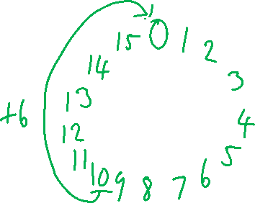
BCD Addition – Stage 3
Since our previous answer (Prev) was greater than 9, we need to add 6 to it to bring it back to the valid range (this is also equivalent to subtracting 10 – e.g. 13 going to 3 – i.e. only getting rightmost digit)
Carry | 1 | 1
Prev |  | 1 | 1 | 0 | 0
6 |  | 0 | 1 | 1 | 0
= |  | 0 | 0 | 1 | 0
Since we got a carry out of this stage, we have to add it to the next nibble

Slide 166
BCD Addition – Stage 3
Since we were doing 7 + 5, we have 0s in the 10s column – and just our carry out from the previous digit
Carry
PrevCarry |  |  |  |  | 1
0 |  | 0 | 0 | 0 | 0
0 |  | 0 | 0 | 0 | 0
= |  | 0 | 0 | 0 | 1
Our original 7 + 5 result
= |  | 0 | 0 | 1 | 0
Hence our final answer is 0001 0010 or 12

Slide 167
BCD Addition
Let’s see all of these stages together…

Slide 168
Carry |  |  |  |  |  |  |  |  |  |  |  |  | 1
0.26 |  |  |  |  |  |  |  |  | 0 | 0 | 1 | 0 | 0 | 1 | 1 | 0
0.85 |  |  |  |  |  |  |  |  | 1 | 0 | 0 | 0 | 0 | 1 | 0 | 1
Nibble 1 Ans |  |  |  |  |  |  |  |  |  |  |  |  | 1 | 0 | 1 | 1
Carry |  |  |  |  |  |  |  |  |  |  |  |  | 1 | 1
Nibble 1 Ans > 9 |  |  |  |  |  |  |  |  |  |  |  |  | 1 | 0 | 1 | 1
6 |  |  |  |  |  |  |  |  |  |  |  |  | 0 | 1 | 1 | 0
Nibble 1 Ans |  |  |  |  |  |  |  |  |  |  |  | 1 | 0 | 0 | 0 | 1
Carry
Nibble 1 Ans Carry Bit |  |  |  |  |  |  |  |  |  |  |  | 1
0.26 |  |  |  |  |  |  |  |  | 0 | 0 | 1 | 0
0.85 |  |  |  |  |  |  |  |  | 1 | 0 | 0 | 0
Nibble 2 Ans |  |  |  |  |  |  |  |  | 1 | 0 | 1 | 1
Carry |  |  |  |  |  |  |  | 1 | 1 | 1
Nibble 2 Ans > 9 |  |  |  |  |  |  |  |  | 1 | 0 | 1 | 1
6 |  |  |  |  |  |  |  |  | 0 | 1 | 1 | 0
Nibble 2 Ans |  |  |  |  |  |  |  |  | 0 | 0 | 0 | 1
Final Answer in BCD |  |  |  |  |  |  |  | 1 | 0 | 0 | 0 | 1 | 0 | 0 | 0 | 1
Final Answer in Denary |  |  |  |  | 1. |  |  |  | 1 |  |  |  | 1
?
?
?
Answer

Slide 169
BCD Addition
Let’s try summing 0.93 and 0.58

Slide 170
Carry
6.4 |  |  |  |  |  |  |  |  | 0 | 1 | 1 | 0 | 0 | 1 | 0 | 0
7.8 |  |  |  |  |  |  |  |  | 0 | 1 | 1 | 1 | 1 | 0 | 0 | 0
Nibble 1 Ans |  |  |  |  |  |  |  |  |  |  |  |  | 1 | 1 | 0 | 0
Carry |  |  |  |  |  |  |  |  |  |  |  | 1 | 1
Nibble 1 Ans > 9 |  |  |  |  |  |  |  |  |  |  |  |  | 1 | 1 | 0 | 0
6 |  |  |  |  |  |  |  |  |  |  |  |  | 0 | 1 | 1 | 0
Nibble 1 Ans |  |  |  |  |  |  |  |  |  |  |  | 1 | 0 | 0 | 1 | 0
Carry |  |  |  |  |  |  |  |  | 1 | 1 | 1
Nibble 1 Ans Carry Bit |  |  |  |  |  |  |  |  |  |  |  | 1
6.4 |  |  |  |  |  |  |  |  | 0 | 1 | 1 | 0
7.8 |  |  |  |  |  |  |  |  | 0 | 1 | 1 | 1
Nibble 2 Ans |  |  |  |  |  |  |  |  | 1 | 1 | 1 | 0
Carry |  |  |  |  |  |  |  | 1 | 1 | 1
Nibble 2 Ans > 9 |  |  |  |  |  |  |  |  | 1 | 1 | 1 | 0
6 |  |  |  |  |  |  |  |  | 0 | 1 | 1 | 0
Nibble 2 Ans |  |  |  |  |  |  |  |  | 0 | 1 | 0 | 0
Final Answer in BCD |  |  |  |  |  |  |  | 1 | 0 | 1 | 0 | 0 | 0 | 0 | 1 | 0
Final Answer in Denary |  |  |  |  | 1 |  |  |  | 4. |  |  |  | 2
?
?
?
Answer

Slide 171
BCD Addition
This is quite a difficult process to remember, which is probably one of the reasons it’s never been on the exam (though it is in the book)
You can try more for homework for practice though – you can easily check the answer yourself by converting the BCD answer to denary and check it’s the same as performing the original denary calculation on your calculator
5.4 + 6.7
1.94 + 0.8

Slide 172
Binary-Coded Decimal Disadvantages
If BCD allows us to store decimal numbers exactly, why don’t we use it instead of two’s complement?
Wasteful – 6 of 16 values in 4 bits aren’t used
Requires more complex circuitry to store & perform arithmetic
Slower

Slide 173
BCD Recap: Advantages, Disadvantages & Uses
Advantage:
Can store base-10 decimal numbers exactly
Disadvantages:
Wastes 6 out of 16 bits
Complex circuitry for arithmetic required
Slower
Used in SOME:
Digital watches/timers/stopwatches/alarms
Scientific equipment – voltmeters, oscilloscopes etc
Programs to represent financial values exactly

Slide 174

9618 AS
Unit 1
Internal Coding of Text

Slide 175
Class Overview
Character sets: ASCII & Unicode
Standard vs Extended ASCII
UTF-8, UTF-16 & UTF-32
ASCII codes of some common characters
Why some languages use more storage space

Slide 176
Internal Coding of Text
As mentioned – numbers, images, videos, sound, text, programs etc all have to be stored as binary
Therefore we need a representation of characters in binary – these are ASCII and, later, Unicode character sets
Character set: a collection of characters whereby each character is represented with a unique binary code

Slide 177
ASCII
Stands for American Standard Code for Information Interchange
Standardised by ANSI (American National Standards Institute) in 1963
There are 2 versions – 7-bit (standard) ASCII and 8-bit (extended) ASCII
Every bit pattern is used to represent a character – how many characters would be able to be represented by both versions?
Standard (7-bit) ASCII = 128 characters (2⁷)
Extended (8-bit) ASCII = 256 characters (2⁸)

Slide 178

ASCII Art
Unrelated – but most people have probably seen ASCII art in online comments etc
If you zoom in, you can see this image is made just from 2 characters – ‘0’ and ‘1’

Slide 179
DEC | OCT | HEX | BIN | Symbol | HTML Number | HTML Name | Description
0 | 000 | 00 | 00000000 | NUL | &#000; |  | Null char
1 | 001 | 01 | 00000001 | SOH | &#001; |  | Start of Heading
2 | 002 | 02 | 00000010 | STX | &#002; |  | Start of Text
3 | 003 | 03 | 00000011 | ETX | &#003; |  | End of Text
4 | 004 | 04 | 00000100 | EOT | &#004; |  | End of Transmission
5 | 005 | 05 | 00000101 | ENQ | &#005; |  | Enquiry
6 | 006 | 06 | 00000110 | ACK | &#006; |  | Acknowledgment
7 | 007 | 07 | 00000111 | BEL | &#007; |  | Bell
8 | 010 | 08 | 00001000 | BS | &#008; |  | Back Space
9 | 011 | 09 | 00001001 | HT | &#009; |  | Horizontal Tab
10 | 012 | 0A | 00001010 | LF | &#010; |  | Line Feed
11 | 013 | 0B | 00001011 | VT | &#011; |  | Vertical Tab
12 | 014 | 0C | 00001100 | FF | &#012; |  | Form Feed
13 | 015 | 0D | 00001101 | CR | &#013; |  | Carriage Return
There are 32 non-printable ASCII characters (0-31) – 13 are shown here
These include things like tabs, new lines (\n = line feed), backspace, null characters etc

Slide 180
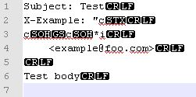
For example, this image shows the data when an email is sent to an email server
Note the email subject, CC, body
CR LF = new line (carriage return + line feed)
STX = start of text
SOH = start of heading
GS = group separator
So note how you wouldn’t actually see these characters when you read the email – but they are included in the email transmission for the email client to parse/display the email

Slide 181
DEC | OCT | HEX | BIN | Symbol | HTML Number | HTML Name | Description
32 | 040 | 20 | 00100000 |  | &#32; |  | Space
33 | 041 | 21 | 00100001 | ! | &#33; |  | Exclamation mark
34 | 042 | 22 | 00100010 | " | &#34; | &quot; | Double quotes (or speech marks)
35 | 043 | 23 | 00100011 | # | &#35; |  | Number
36 | 044 | 24 | 00100100 | $ | &#36; |  | Dollar
37 | 045 | 25 | 00100101 | % | &#37; |  | Per cent sign
38 | 046 | 26 | 00100110 | & | &#38; | &amp; | Ampersand
39 | 047 | 27 | 00100111 | ' | &#39; |  | Single quote
40 | 050 | 28 | 00101000 | ( | &#40; |  | Open parenthesis (or open bracket)
41 | 051 | 29 | 00101001 | ) | &#41; |  | Close parenthesis (or close bracket)
42 | 052 | 2A | 00101010 | * | &#42; |  | Asterisk
43 | 053 | 2B | 00101011 | + | &#43; |  | Plus
44 | 054 | 2C | 00101100 | , | &#44; |  | Comma
45 | 055 | 2D | 00101101 | - | &#45; |  | Hyphen
46 | 056 | 2E | 00101110 | . | &#46; |  | Period, dot or full stop
47 | 057 | 2F | 00101111 | / | &#47; |  | Slash or divide
Then there are some of the common punctuation/symbols

Slide 182
DEC | OCT | HEX | BIN | Symbol | HTML Number | HTML Name | Description
48 | 060 | 30 | 00110000 | 0 | &#48; |  | Zero
49 | 061 | 31 | 00110001 | 1 | &#49; |  | One
50 | 062 | 32 | 00110010 | 2 | &#50; |  | Two
51 | 063 | 33 | 00110011 | 3 | &#51; |  | Three
52 | 064 | 34 | 00110100 | 4 | &#52; |  | Four
53 | 065 | 35 | 00110101 | 5 | &#53; |  | Five
54 | 066 | 36 | 00110110 | 6 | &#54; |  | Six
55 | 067 | 37 | 00110111 | 7 | &#55; |  | Seven
56 | 070 | 38 | 00111000 | 8 | &#56; |  | Eight
57 | 071 | 39 | 00111001 | 9 | &#57; |  | Nine
Sometimes the exam includes questions that require you to know that 0 has a denary value of 48 in ASCII – if you remember that, figuring out another number is easy – they just increment – 0 = 48, 1 = 49, 2 = 50 etc
Note: these values are just used for when numbers are stored as text – when a number is stored as an integer for arithmetic, its two’s complement value would be used

Slide 183
DEC | OCT | HEX | BIN | Symbol | HTML Number | HTML Name | Description
48 | 060 | 30 | 00110000 | 0 | &#48; |  | Zero
49 | 061 | 31 | 00110001 | 1 | &#49; |  | One
50 | 062 | 32 | 00110010 | 2 | &#50; |  | Two
51 | 063 | 33 | 00110011 | 3 | &#51; |  | Three
52 | 064 | 34 | 00110100 | 4 | &#52; |  | Four
53 | 065 | 35 | 00110101 | 5 | &#53; |  | Five
54 | 066 | 36 | 00110110 | 6 | &#54; |  | Six
55 | 067 | 37 | 00110111 | 7 | &#55; |  | Seven
56 | 070 | 38 | 00111000 | 8 | &#56; |  | Eight
57 | 071 | 39 | 00111001 | 9 | &#57; |  | Nine
With this logic, what would the denary value of 8 be in ASCII?

Slide 184
DEC | OCT | HEX | BIN | Symbol | HTML Number | HTML Name | Description
65 | 101 | 41 | 01000001 | A | &#65; |  | Uppercase A
66 | 102 | 42 | 01000010 | B | &#66; |  | Uppercase B
67 | 103 | 43 | 01000011 | C | &#67; |  | Uppercase C
… | … | … | … | … | … |  | …
88 | 130 | 58 | 01011000 | X | &#88; |  | Uppercase X
89 | 131 | 59 | 01011001 | Y | &#89; |  | Uppercase Y
90 | 132 | 5A | 01011010 | Z | &#90; |  | Uppercase Z
Likewise, the upper case letters follow the same pattern – starting with ‘A’ at denary value 65, with ‘Z’ at 90 – again, you need to remember ‘A’ = 65

Slide 185
DEC | OCT | HEX | BIN | Symbol | HTML Number | HTML Name | Description
97 | 141 | 61 | 01100001 | a | &#97; |  | Lowercase a
98 | 142 | 62 | 01100010 | b | &#98; |  | Lowercase b
99 | 143 | 63 | 01100011 | c | &#99; |  | Lowercase c
… | … | … | … | … | … |  | …
120 | 170 | 78 | 01111000 | x | &#120; |  | Lowercase x
121 | 171 | 79 | 01111001 | y | &#121; |  | Lowercase y
122 | 172 | 7A | 01111010 | z | &#122; |  | Lowercase z
Again, for lower case, remember that ‘a’ is 97 in denary – hence ‘z’ will be +25 = 122

Slide 186
DEC | OCT | HEX | BIN | Symbol
65 | 101 | 41 | 01000001 | A
66 | 102 | 42 | 01000010 | B
67 | 103 | 43 | 01000011 | C
… | … | … | … | …
88 | 130 | 58 | 01011000 | X
89 | 131 | 59 | 01011001 | Y
90 | 132 | 5A | 01011010 | Z
DEC | OCT | HEX | BIN | Symbol
97 | 141 | 61 | 01100001 | a
98 | 142 | 62 | 01100010 | b
99 | 143 | 63 | 01100011 | c
… | … | … | … | …
120 | 170 | 78 | 01111000 | x
121 | 171 | 79 | 01111001 | y
122 | 172 | 7A | 01111010 | z
[Bits are always counted from right-to-left]
The 6th bit is a 0 in the uppercase version…but a 1 in the lowercase version
This is because bit 6 = 32 (and 97 – 65 = 32)
This also means the 2nd hex digit is 2 greater in the lowercase version than the uppercase version – i.e. 41 → 61
Do you notice a relationship of the binary values between the corresponding lowercase → uppercase letter

Slide 187
Example
We can use an online tool like https://www.toptal.com/developers/keycode to see details about the keys we pressed
Note: this gives 65 as the keycode for both ‘A’ and ‘a’ – but ‘a’ should be 97. So be careful about that

Slide 188
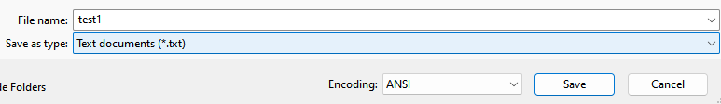
Example
Let’s look at a real file – I saved some text using Notepad and setting the encoding option to extended ASCII
[Notepad calls this ANSI, but for the exam, this is just extended (8-bit) ASCII]

Slide 189

Example
We can then use a hex editor to see the binary contents (displayed in hex) of any file – I will use a program called HxD, though there are many online hex editors too
We see there are two bytes in the file – 48 & 69 – note these are HEX values, not denary
We said that extended ASCII uses 1 byte (8 bits) per character, so what would the text content of this file be?

Slide 190
Example
48₁₆ = 72₁₀= ‘H’
69₁₆ = 105₁₀ = “i”
So the message was “Hi” – and it used just 2 bytes

Slide 191
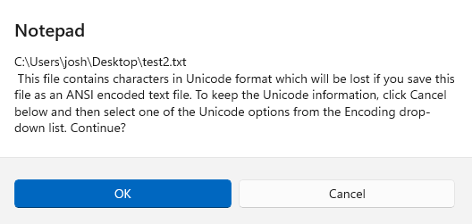
Example
Now let’s try saving “你好” using ASCII – what do you think will happen?
We get an error – remember, extended ASCII only supports 256 characters
So characters from most languages, scientific/mathematical symbols, even emojis like 🎂 can’t be represented with ASCII

Slide 192

Example
Challenge: what are the contents of this file?
0
A
a
0D and 0A represent the carriage return and line-feed (new line) respectively

Slide 193
Unicode
To offer more than 256 characters, Unicode was introduced
Unicode can represent all characters in every language, all mathematical/scientific symbols, all emojis etc
In fact, there are even many symbols in Unicode which no one in the world knows what they are – but because they were written once in a textbook from 1800, they’re included
Currently, there are 144,697 characters in Unicode – with room for over 1.1 million

Slide 194
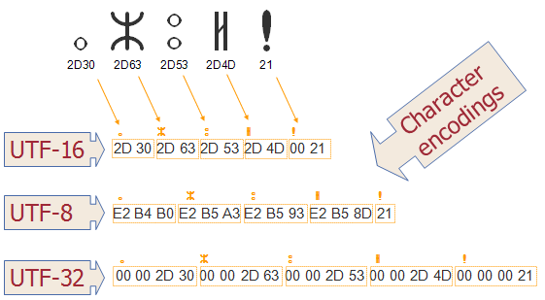
Unicode
Unicode offers variable-length schemes – characters will be represented by between 1 to 4 bytes
UTF = Unicode Transformation Format
You don’t need to remember the full name – only that UTF = Unicode

Slide 195
Unicode
Note: all schemes can represent ALL Unicode characters
UTF-16 & UTF-32: fast to get specific character(s) at an index/in a range due to fixed-size; in contrast UTF-8 requires searching through entire string
UTF-8: uses less space, especially when working with e.g. Latin alphabetic characters, numbers etc, since they are also ASCII characters are only require 1 byte

Slide 196
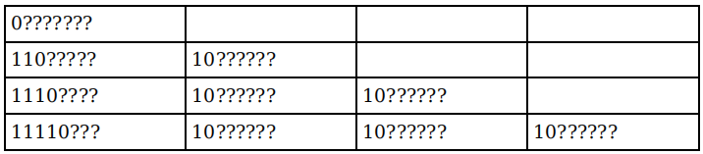
Unicode
For UTF-8, characters can be between 1-4 bytes - bytes start with the fixed pattern shown below, so that decoders can determine the which bytes are for what character/when a new character starts/ends
While this is in the book, it’s never been asked on the exam

Slide 197
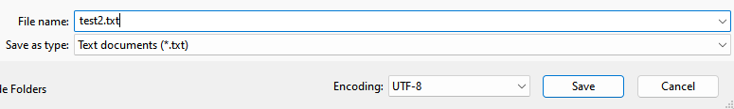
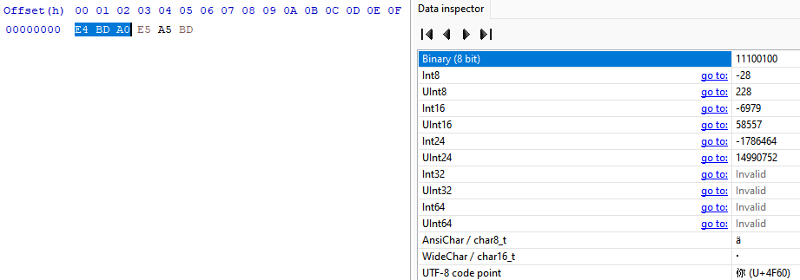
Example
Let’s try saving “你好” using UTF-8 this time
You can see each character takes 3 bytes – for reference, 🎂 uses 4 bytes

Slide 198
Text Encoding Summary
Character set: collection of characters where each character has a unique binary code – ‘0’ = 48, ‘A’ = 65, ‘a’ = 97
ASCII:
Older
Two versions: standard (7-bit) and extended (8-bit) can represent 128 & 256 characters accordingly
Unicode:
Can represent all characters
Uses between 1-4 bytes per character

Slide 199
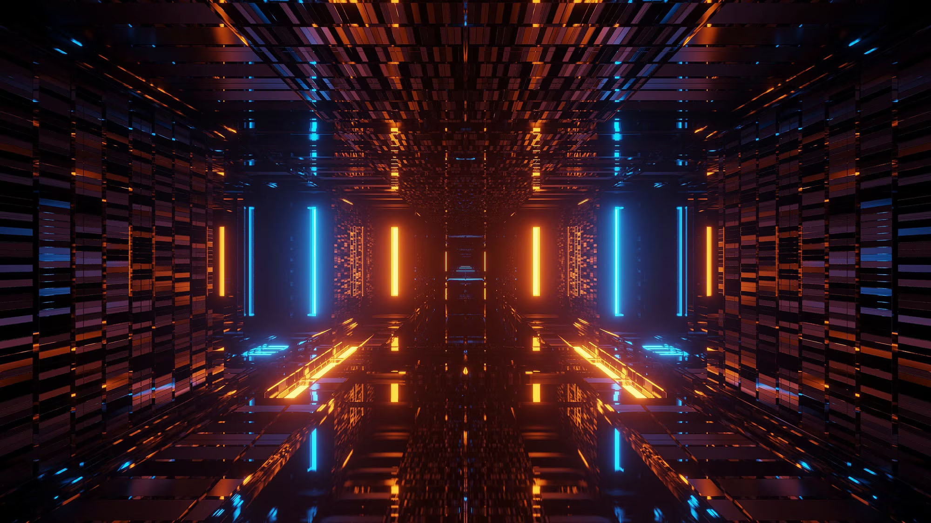
9618 AS
Unit 1
Images

Slide 200
Class Overview
Categories of image: bitmap & vector
Vector & bitmap uses
Key terms: resolution, colour depth, pixel, element, drawing list etc
Calculating image file size
Image header

Slide 201
Images
There are 2 categories of images we will look at:
Bitmap
Vector
Bitmaps you are probably familiar with – common file formats include: jpg, png, gif, tiff, bmp, webp, avif etc
Vectors possibly not – svg

Slide 202
Bitmaps
Consist of individual picture elements – pixels
Pixel: the smallest unit of an image or graphic that can be displayed on a digital device
Each pixel has a colour value – could be RGB, black & white etc
For example, an RGB value of FF0000 = 255 red, 0 green & 0 blue
Resolution = number of pixels in image (i.e. higher resolution = higher quality)
Bitmaps can be considered a 2D array (matrix) of pixels
Bit depth/colour depth = number of bits to represent colour for each pixel

Slide 203
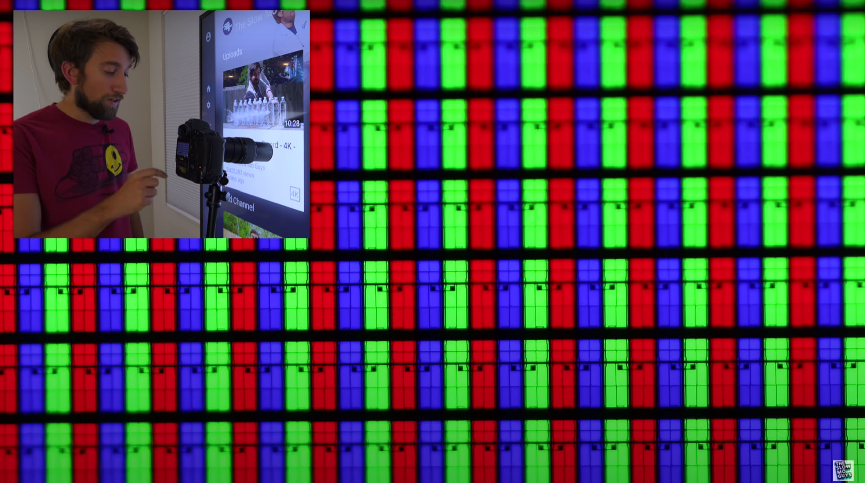
This picture shows a camera zooming in on the pixels on a screen – you can see how each pixel actually consists of 3 sub-pixels (RGB)
Note how since this is white, we have all sub pixels on – i.e. FFFFFF

Slide 204

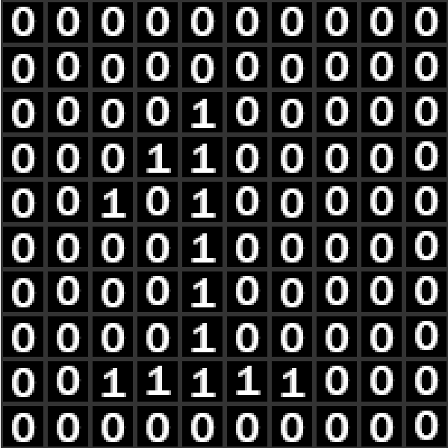
Bitmap Example
Here is a zoomed-in picture – each grid cell represents 1 pixel
What is the resolution of this image?
10x10
How many bits do you think would be needed to represent black & white image?
Only 1 - e.g. 0 = black; 1 = white

Slide 205
Bitmap Example
What would the colour/bit depth of this image be?
1
Can you then figure out the file size of an image? And can you figure out the formula?
Intuitively: num pixels * size of each pixel
Specifically = resolution * bit depth
= (10 * 10) * 1 = 100bits

Slide 206
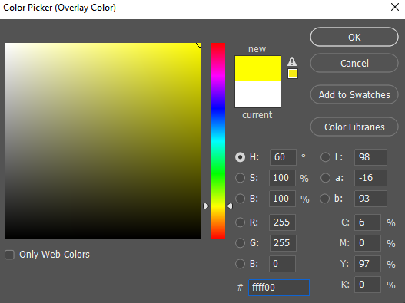
Colour Bitmaps
As mentioned, coloured bitmap images often use 6 hex digits like FFFF00 – how many bits are being used? And do you know what colour this would be?
1 hex digit = 4 bits. So 6 hex digits = 24 bits
255 red, 255 green & 0 blue – so the pixel would be yellow
What colour would FFFF00 be?

Slide 207
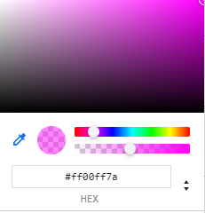
Colour Bitmaps
As well as 24-bit RGB, 32-bit RGBA is also common
The ‘A’ stands for “alpha” which is the opacity – i.e. 00 = completely transparent, while FF = completely opaque

Slide 208
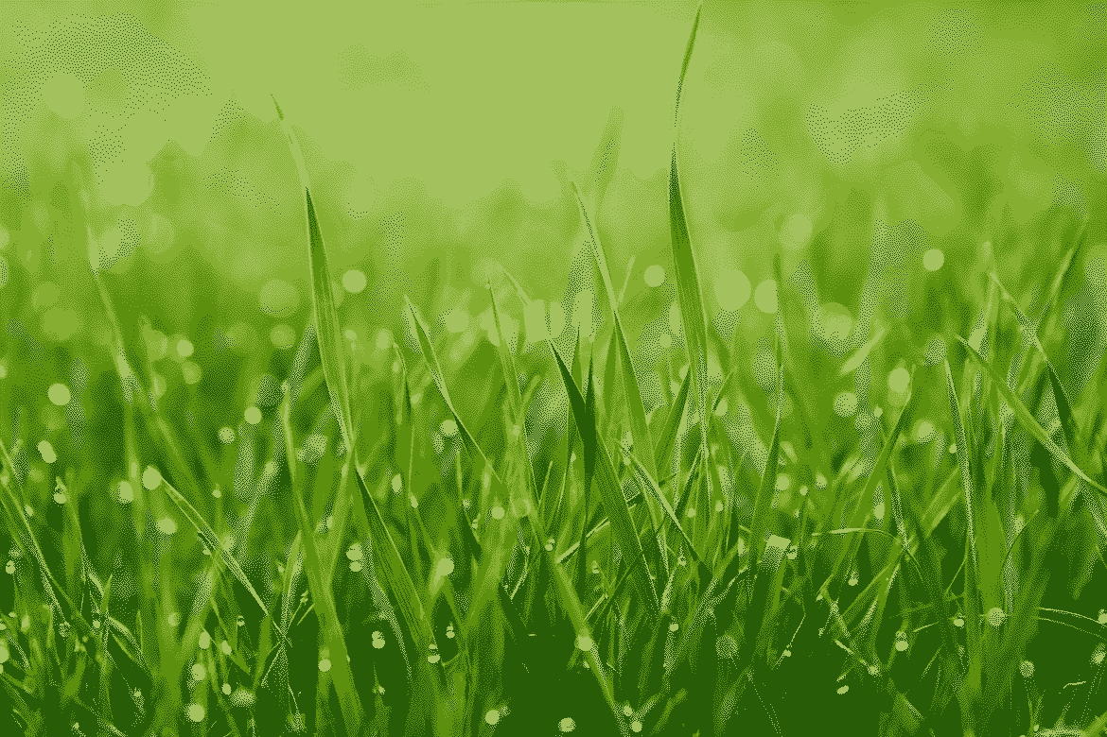
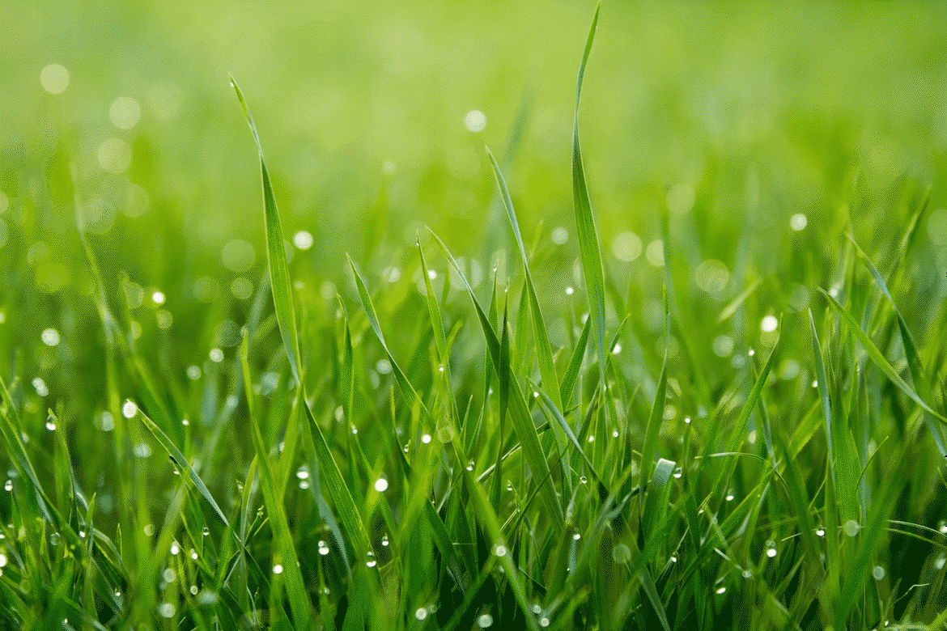
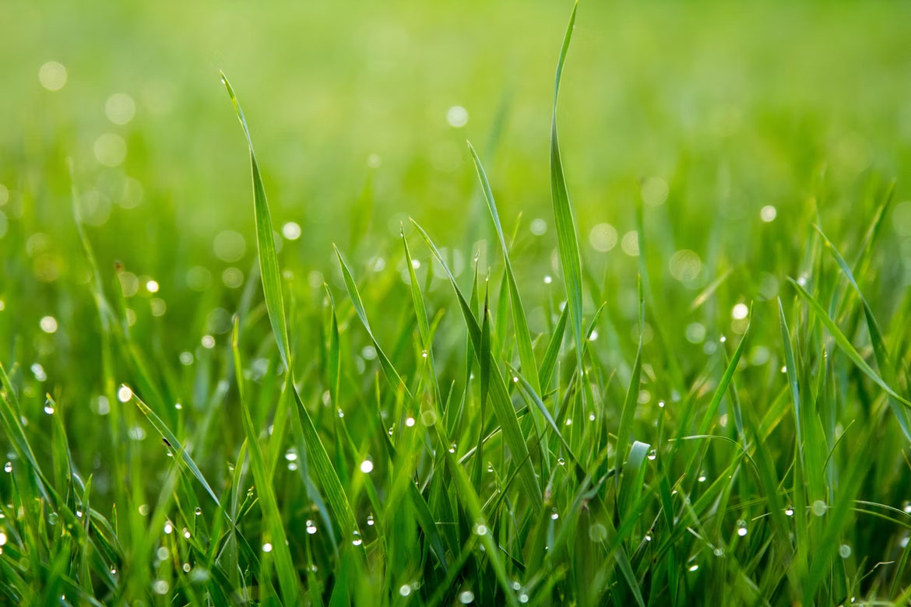
Colour Bitmaps
4 colours
4 bits per pixel
(2 bits not supported)
337KB
We can actually use any number of bits for each pixel
Here are 3 images with a different number of available colours and bit/colour depth – the file sizes are also listed
50 colours
8 bits per pixel
817KB
16,777,216 colours
24 bits per pixel
2,676KB (2.676MB)

Slide 209
Colour Bitmaps
We can see the differences more if we view them in full screen
All images have a resolution of 1170x780px

Slide 210
4 colours
4 bits per pixel
337KB

Slide 211
50 colours
8 bits per pixel
817KB

Slide 212
16,777,216 colours
24 bits per pixel
2,676KB (2.676MB)

Slide 213
Colour Bitmaps
Just by experimenting, using 256 colours was quite good – using 256 colours also used a similar file size to using 50 colours – do you have any ideas why?
The .bmp image format supports bit depths of 1, 4, 8, 16, 24 & 32 – 50 colours is too many for 4 bits (only supports 2⁴ = 16 different colours), so both would be stored using 8 bits (max 256 different colours)
The 256 colour version was slightly bigger (894KB vs 817KB), but that’s because it couldn’t be compressed as much with run-length encoding

Slide 214


Colour Bitmaps
4 colours
4 bits per pixel
337KB
We have seen a picture of grass using only 4 different colour values – how do you think a more colourful image would appear, if using only 4 different colours?
4 colours
4 bits per pixel
289KB
As you can see, reducing the colour depth on an image with many similar colours is ok – reducing it too much on an image with many different colours isn’t
16,777,216 colours
24 bits per pixel
2676KB (2.676MB)

Slide 215
Image Headers
Many file types – both images and others - .jpg, .png, .mp3, .mp4, .exe, .doc, .pdf, .gif etc contain headers
A header is additional information at the start of the file that often defines metadata (some files also include trailers/footers too – additional metadata at the end of the file)
Let’s see the kinds of things stored in an image header
Header | Image Data

Slide 216
Image Headers
What additional data do you think might be contained within the image header?
File type
Resolution
Bit depth
Title
Description
Camera used
Geolocation
Time taken
Program used
etc

Slide 217
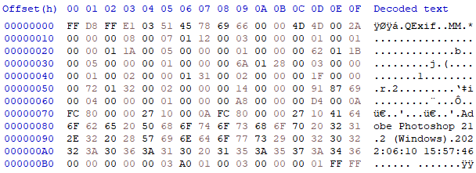
Image Headers
For example, here is a 1x1 white pixel – you would assume the file size would be small - yet it is over 8KB (equivalent to 8,000 extended ASCII characters)
In this small section, can you notice anything in the decoded text?
It says the image was saved with Photoshop 21.1 (Windows) and includes the date/time
Resolution, bit depth, colour profile etc are also included
All .jpg files start FF D8 FF – change these bytes & programs won’t know it’s a .jpg, hence won’t be able to display it – these are called “Magic Bytes”

Slide 218
Calculating Image Size
Do you remember the formula/method to calculate the filesize of an image?
Image filesize = resolution * bit depth
What unit will this answer be in?
Bits – so you’d then need to convert to an appropriate unit/the unit the question specifies

Slide 219
Colour Bitmaps
We said this picture of grass was 337KB, with a bit depth of 4 and resolution of 1170x780px – ignoring the size of image headers, by how many KB has this image been compressed due to run-length encoding?
Expected number of bits (b):
1170 * 780 * 4 = 3,650,400
In KB:
3,650,400 / (8 * 1000) = 456.3KB
456.3 – 337 = 119.3KB have been reduced due to run-length encoding

Slide 220
Calculating Image Size
A photographer takes a 5000x4000px image, with a bit depth of 32 – what would the expected size of the image be (ignoring compression/file headers) – give your answer in an appropriate unit
80MB or 76.3 MiB

Slide 221
Calculating Image Size
No calculator
An RGBA image is 4096x512px – it’s saved using a bit depth of 32 bits. Calculate the file size of this image in Mebibytes
(4096 * 512 * 32) / (1024 * 1024 * 8)
Simplify by dividing each term: 4 * 0.5 * 4
Final answer = 8MiB

Slide 222
Questions
A company has 50,000 photos at an average of 3MiB – they see a 200GB HDD for €60 and some 32GB USB memory sticks for €10 each – would they be better off buying the 1HDD or multiple USBs?
Total file size in GB = ((50,000 * 3) * 2²⁰) / 10⁹ = 157.3 GB
5 USBs required = €50, so the USBs would be slightly cheaper

Slide 223
Vector Images
Along with bitmaps, the other type of images are vectors
Rather than being defined in terms of pixels, they are defined in terms of shapes, co-ordinates, properties etc
For example, you can create ellipses (circles/ovals), rectangles/squares, polygons, lines, text etc
The main advantages of vectors are a smaller file size for certain types of images (logos etc that can be comprised of shapes) and the fact you can scale to any size, without reducing image quality

Slide 224

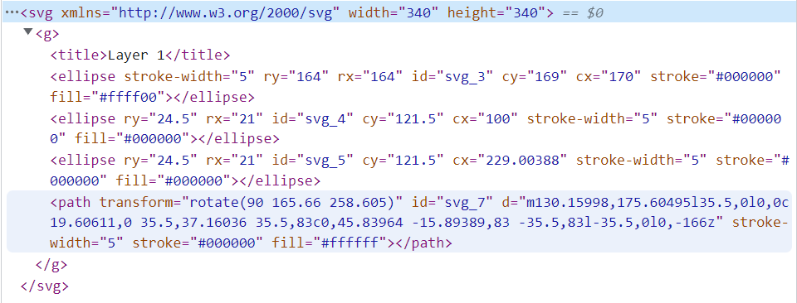
Vector Images
Here is a smiley face and the code required to create it
Note the elements like ellipse & path, their attributes like stroke-width, ry/rx (radius y/x), cy/cx (center y/x), stroke, fill etc and values

Slide 225
Vector Terminology
Element/drawing object: an individual component of a vector image
Drawing list: the collection of all elements
Attributes/properties: additional information about an element
Value: value of an attribute/property
<rect x="120" width="100" height="100" fill=“#f00” />
<line x1="0" y1="80" x2="100" y2="20" stroke=“blue" />

Slide 226

Bitmap vs Vector
Can you tell which version is the bitmap version vs which is the vector?
Probably not…but let’s zoom in

Slide 227


Bitmap vs Vector
The right is the vector image – no matter how much you zoom in/resize, image quality never decreases!
This is because elements & properties are defined mathematically – we can just multiply by x & y scale factors

Slide 228
Bitmap vs Vector
What about the file size – both are 340x340px, but which do you think has a smaller file size?
Bitmap = 16.3KB Vector = 672 Bytes
So how much smaller is the vector?
About 24.3x!
Note: this file size reduction would be even more extreme if they images were larger (e.g. 1920x1920px)

Slide 229
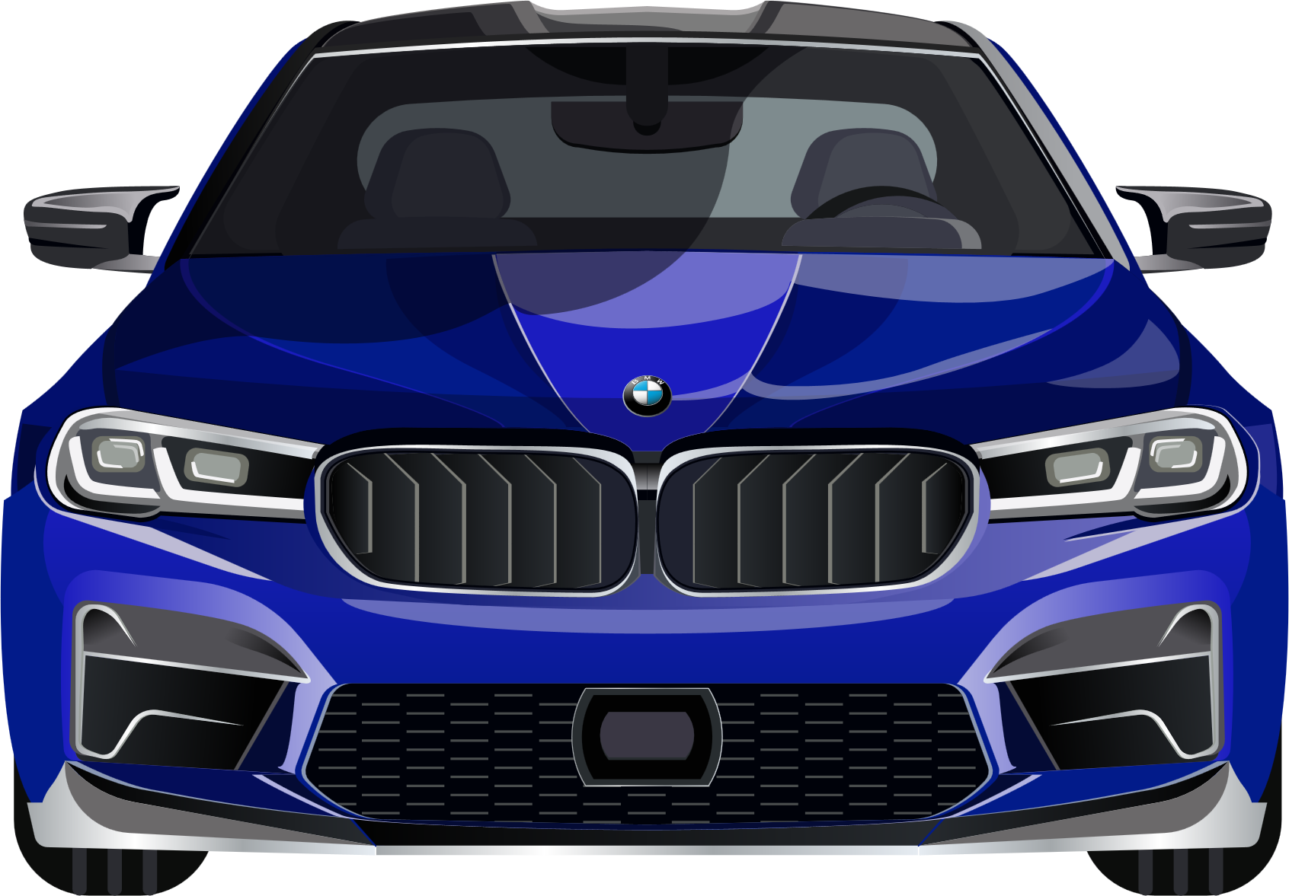
Vector Example
Vectors aren’t just for simple images – you can use software like Adobe Illustrator to create complex graphics too
This car is only 91KB and again, could be scaled to the size of an advertising display on a sports stadium, without losing any image quality

Slide 230
Vector Drawbacks?
Can you think of any drawbacks with vectors? What if we wanted to store a complex image like a photo?
Photos can’t be represented well with shapes – technically we could make every pixel a 1x1 square, but then you would go from something like this:
Bitmap: 0000FF
Vector: <rect x=“300“ y=“400” width=“1" height=“1" fill=“#00f”></rect>
What would be size of each, for 1 pixel?
Bitmap: 3 bytes ; Vector = 62 ASCII characters = 62 bytes
…so representing photos as vectors would take up more space

Slide 231
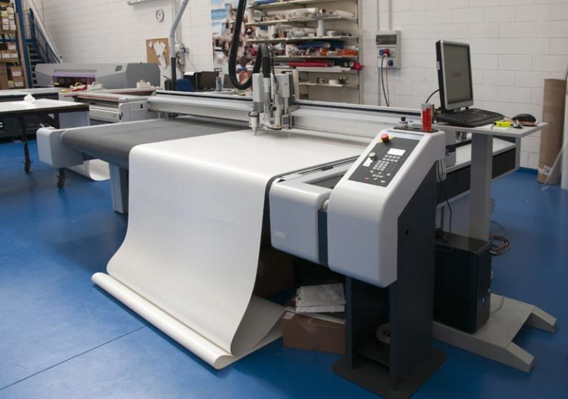
Vector Drawbacks?
Something else to note is that many devices – screens, inkjet/laser printers etc can’t render vectors directly – they need to convert to a bitmap when displaying
A graphics plotter/cutter is required to draw/cut-out a vector

Slide 232
Define the following terms about images:
resolution
pixel
bit depth/colour depth
image header (or file header's generally)
bitmaps
vectors
Name at least 3 things that could be stored in an image header
What is the formula for calculating an image's file size?
Assuming the file is saved optimally, what is the bit depth of a purely black & white image?

Slide 233
What happens to the image size/quality when you increase the resolution & colour depth?
When would it be better to use bitmaps and when would it be better to use vectors?

Slide 234
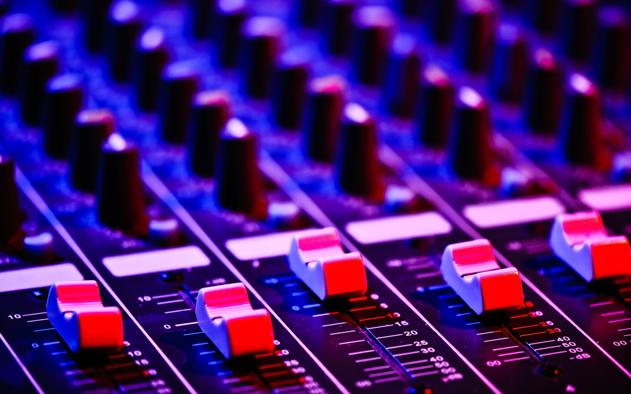
9618 AS
Unit 1
Sound

Slide 235
Class Overview
Key terms: sample, sampling rate/frequency, sampling resolution/bit depth, channels, amplitude
Quantisation
Sampling rate & resolution’s effect on file size and quality
Calculating file size of an audio clip
Extra: Nyquist’s Theorem and Fourier Transforms

Slide 236
Sound
Sound is transferred as pressure waves & detected by our ear drums
Each wave has a frequency & varying amplitude

Slide 237
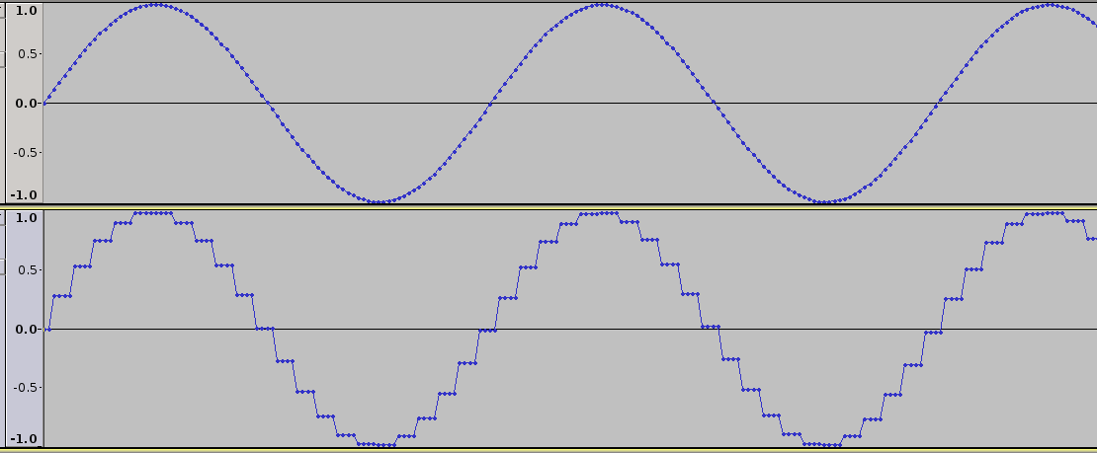
Sound
Sound is analogue – i.e. a varying, continuous signal
Computers can only understand digital (binary) data – so sound has to be quantized (rounded to a discrete level)
Analogue signal
Digital signal

Slide 238
Quantisation
Each discrete ‘step’ in the digital signal is called a quantisation level
An analogue to digital converter (ADC) is required to convert the analogue signal to a digital signal

Slide 239
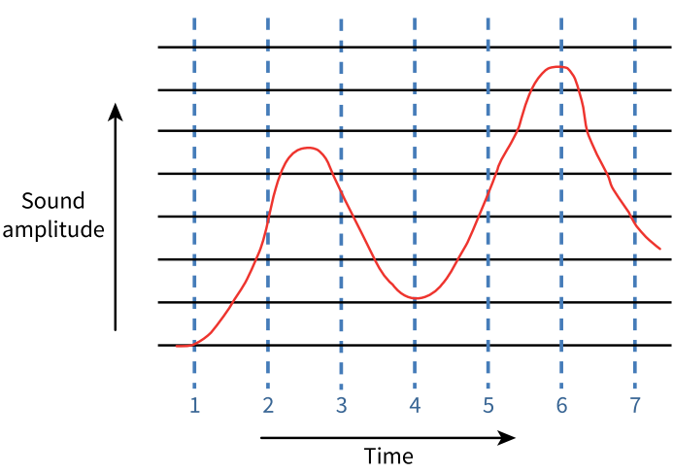
Bit depth/sampling resolution & sampling rate/frequency
Sample: a measurement of the amplitude of the sound at a given instance
Sampling resolution/bit depth: number of bits per sample
Sampling rate/sampling frequency: number of samples per unit time (e.g. per second)

Slide 240
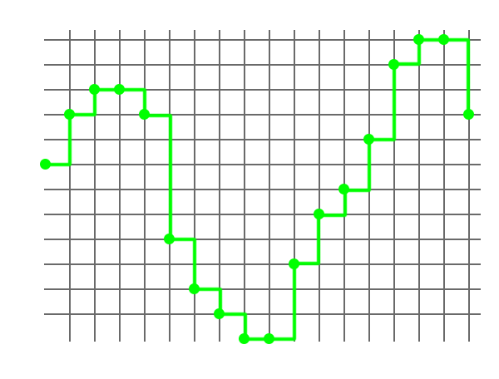
Bit depth/sampling resolution & sampling rate/frequency
Assume this graph represents 1 second – what would the sampling rate & number of quantisation levels be?
Sampling rate: 18Hz
Quantisation levels: 13
How many bits would be required to represent 13 quantisation levels?
4 (4 bits supports 2⁴ = 16 quantisation levels) – i.e. the bit depth/sampling resolution is 4

Slide 241
Bit depth/sampling resolution & sampling rate/frequency
Assume this snapshot represents 0.002 seconds – there are 18 samples as mentioned. What would the sampling rate/frequency (i.e. number of samples per second?) and correct units be?
18 / 0.002 = 9000Hz
i.e. in 1 second, the amplitude of the sound is recorded 9,000 times & each sample uses 4 bits to represent it

Slide 242
Bit depth/sampling resolution & sampling rate/frequency
Sampling rate = 9000Hz
Bit rate = 4 bits
Hence, what would the file size of a 3 minute audio recording be (give your answer in an appropriate unit)?
9000 * 4 * 3 * 60 = 6,480,000 bits total
To MB: / (8 * 10⁶) = 0.81MB
Or in MiB, use 1024 = 0.77MiB
Full conversion to MiB:
(9000 * 4 * 3 * 60) / (8 * 1024 * 1024)

Slide 243
Audio Quality & File Size
What do you think happens to the audio quality & file size as the sampling resolution/bit depth is increased?
Both increase
How about if the sampling rate/sampling frequency increases?
Again, both quality and filesize increase
This is because the quantisation error is smaller – i.e. the sample values can more accurately match the real analogue signal

Slide 244
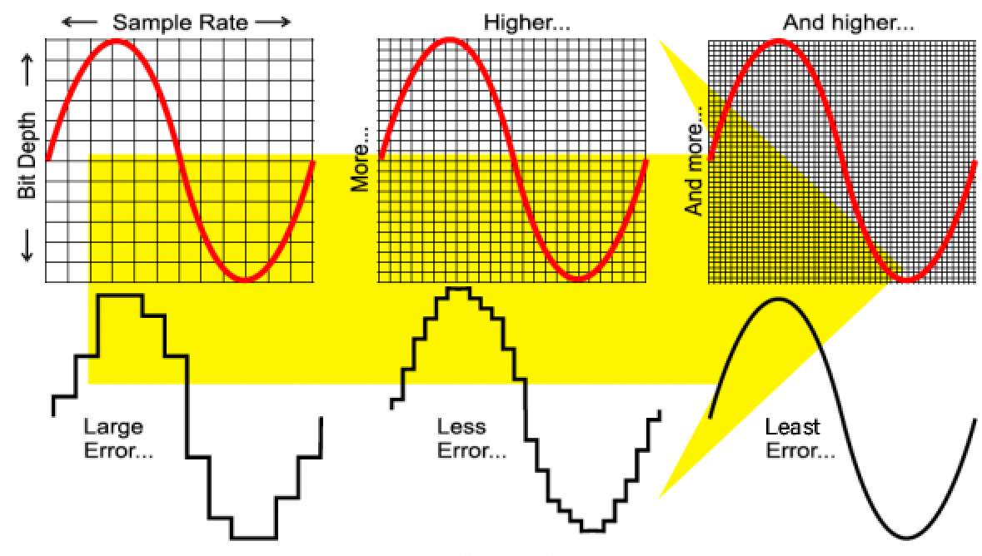

Slide 245

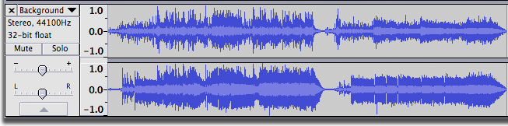
Audio Channels
Note: 2 audio channels means there will be a separate recording for each (left/right) speaker/headphone – hence you’d need to multiply your answer by 2, if an exam questions mentions there are 2 channels (exam assumes 1 channel by default)
In the 2nd picture, even visually, we can see the left & right waveforms are different

Slide 246

Audio Channels
A single audio channel is called mono
Sound with 2 channels is called stereo
Multichannel/surround sound is also possible – e.g. surround sound 7.1 has 8 speakers, arranged as shown

Slide 247
Bit depth/sampling resolution & sampling rate/frequency
Using these settings when exporting audio – and assuming no compression – what would be the file size for a 4 ½ minute song? Use a sensible unit
(44100 * 32 * 60 * 4.5 * 2) / (8 * 1000 * 1000)
95.3MB or 90.8MiB

Slide 248
Sampling Rate
What would be the problem if we sampled at too low a frequency?
We wouldn’t accurately capture the waveform
How about if we sampled at too high a frequency?
The waveform would be accurate – but the file size would be unnecessarily large

Slide 249
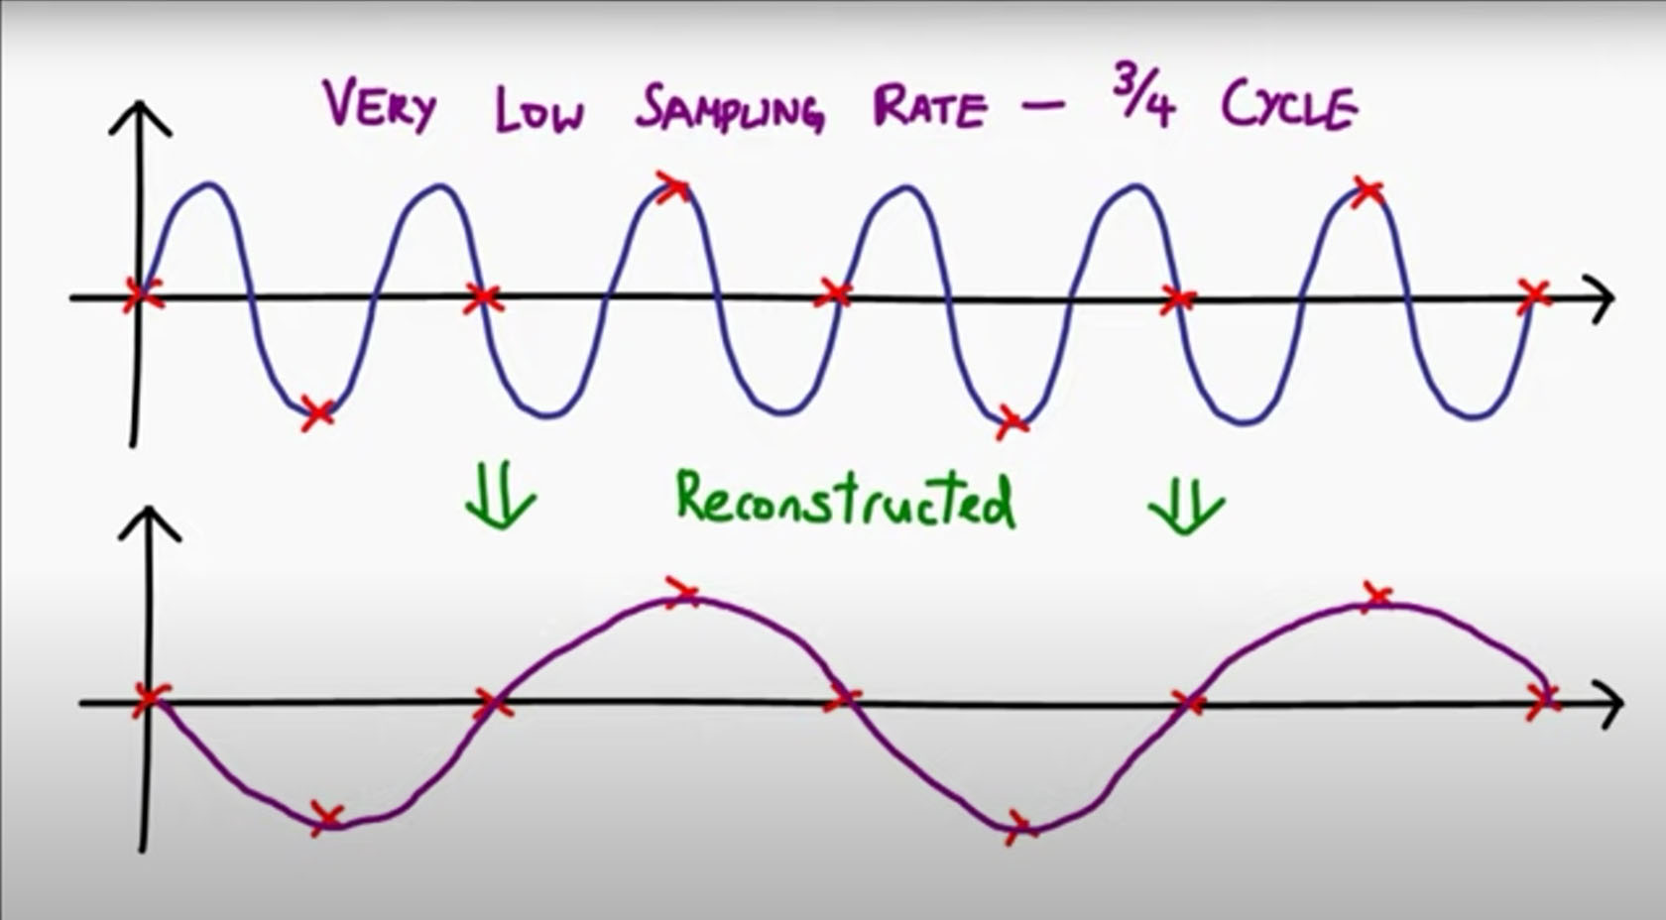

Slide 250
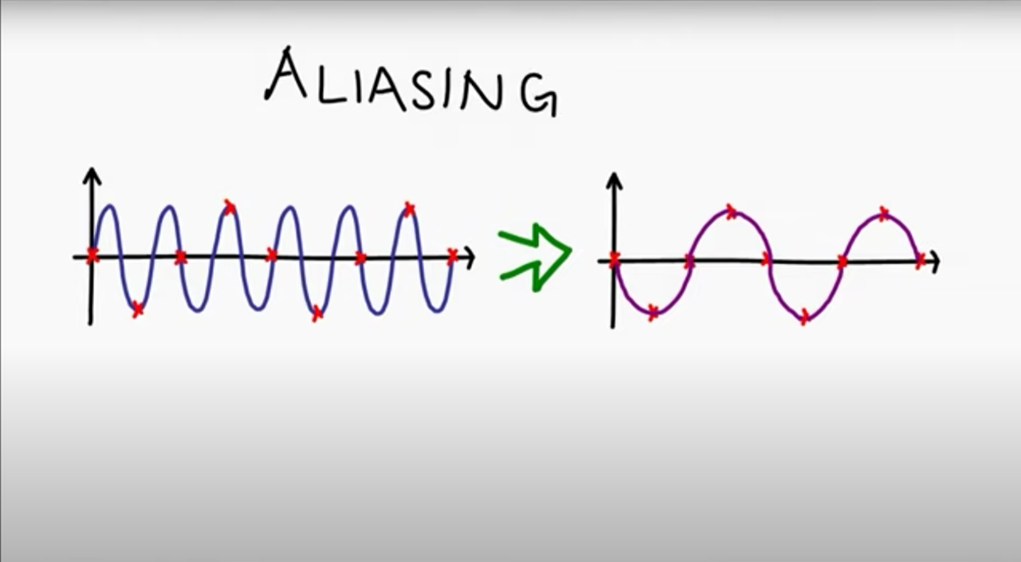
Aliasing: when the sound wave can’t be reconstructed accurately, due to sampling at too low a frequency

Slide 251
Nyquist’s Thereom
States that for a digital signal to be constructed accurately, the sampling rate must be at least 2x the maximum frequency
So for audio designed for humans to hear, we can choose a sampling rate based on the frequency range that humans can hear – do you know what it is?
About 20-20,000Hz
Hence, what would a good sampling rate be, according to Nyquist?
About double 20,000Hz (note: 44,000Hz is usually used…this is because a small number of people may be able to hear up to 22,000Hz, because audio filters have a bit of a run-off area & because if sampling at exactly 2x, you could take all your samples at 0 amplitude)

Slide 252
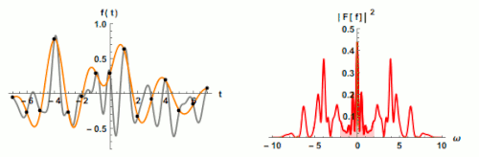
Nyquist’s Thereom
The animation shows the effect of increasing the number of samples taken – as you’d expect, the wave is more accurately represented

Slide 253
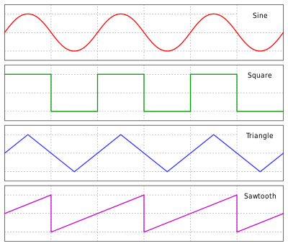
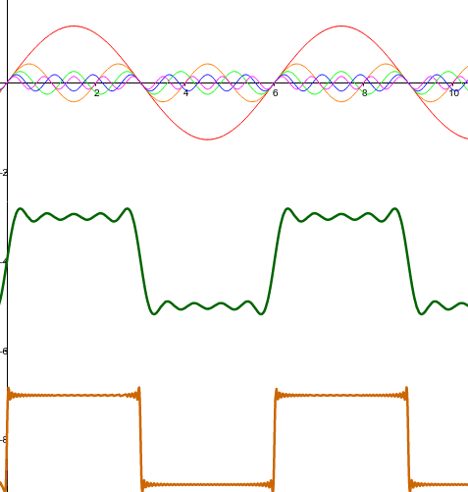
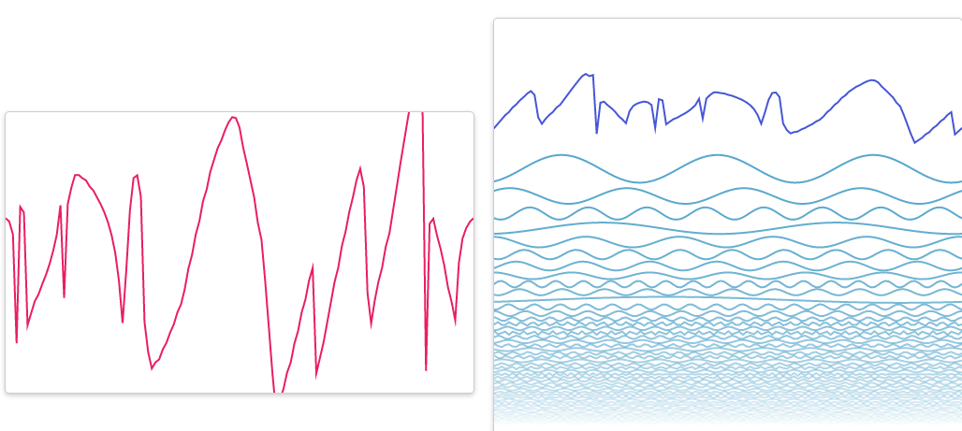
Fourier Transforms
This isn’t required for the exams, but maybe it’s interesting
All wave types can be constructed from sine waves
You can draw a random wave and this site (jezzamon.com/fourier/) will calculate the sine waves required to make it

Slide 254
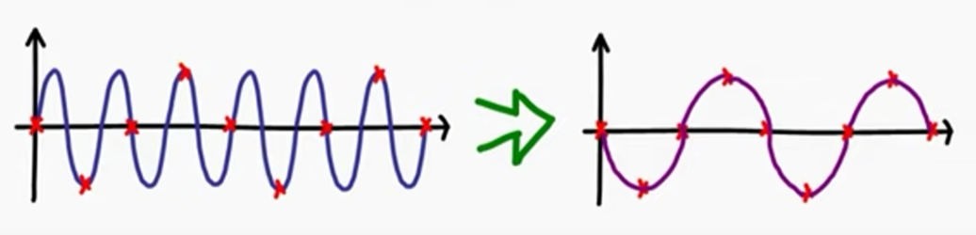
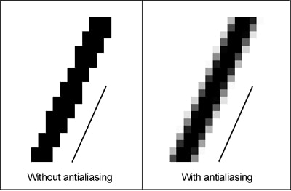
Aliasing
We mentioned that taking too few audio samples results in aliasing – we also have the same effect with images – pixels aren’t small enough to represent the image accurately
This is where images/games/videos etc use anti-aliasing – effectively blurring some of the edges, so it looks smoother, when the viewer views it at normal zoom

Slide 255
Define the following terms:
sample
sampling rate/frequency
sampling resolution/bit depth
amplitude
quantisation
quantisation level
Sample: a measurement of the amplitude of the sound at a given instance
Sampling rate/sampling frequency: number of samples per unit time (e.g. per second)
Sampling resolution/bit depth: number of bits per sample
Amplitude: the volume of the sound at a given time
Quantisation: the process of rounding the measured value up/down to the nearest quantisation level
Quantisation level: a distinct amplitude value that can be represented (increasing sampling resolution = more quantisation levels)

Slide 256
State the formula for calculating an audio track’s file size
sampling rate * duration * sampling resolution * number of channels
Sound in the real world is ________, but has to be converted to ______ to be stored on a device such as a phone/computer
analogue, digital
Explain what happens to the audio quality & file size when the sampling resolution and sampling rate/frequency are increase
Digital sample will more accurately represent original analogue wave – due to having more quantisation levels and a shorter duration between samples, the quantisation error will be reduced. However, more taking more samples and using more bits to store each sample will mean the file size will increase

Slide 257
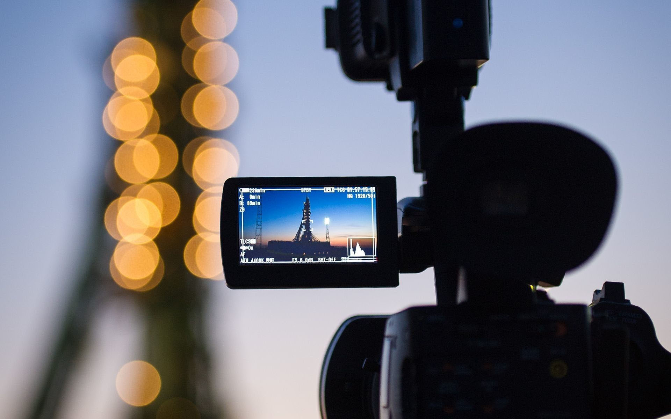
9618 AS
Unit 1
Videos

Slide 258
Video
According to the syllabus, videos are no longer on the syllabus (however, the book still recommends learning about it quickly…so let’s look at a few slides)
[in old exam papers, video questions will occasionally be mentioned…but these questions shouldn’t come up in this new syllabus]

Slide 259
Video
Videos are effectively just many pictures just playing one after another – e.g. if a video is recorded at 30fps (frames per second), that simply means 30 images will be shown per second (i.e. for 1/30th of a second each)
There are two types of video:
Interlaced
Progressive

Slide 260
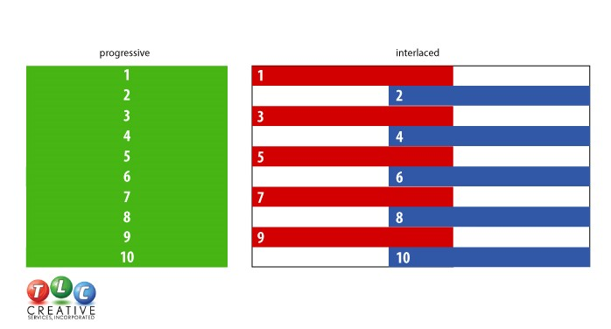
Video
Progressive: shows whole video frame at once
Interlaced: shows odd lines, then even lines, switching between them – old technology did this – why do you think that was?
Due to low bandwidth availability
Old TV stations had a choice: 15fps progressive would use as much data as 30fps interlaced. The fact it was interlaced was barely noticeable – but the higher fps was much more important for quality

Slide 261
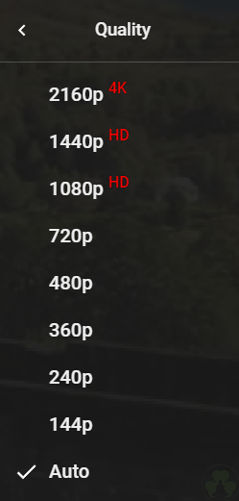
Video
Video formats are advertised as followed:
[vertical resolution][progressive/interlaced][frame rate]
Often the frame rate is omitted – some valid examples:
1080p
720i
2160p60
Note how modern formats are all progressive

Slide 262
Video
Assume the following:
Video format: 1920x1080p60
Image colour depth: 32
No compression
How many MiB would each second of video consume?
= (1920 * 1080 * 60 * 32) / (8 * 1024 * 1024) = 474.6MiB/s
Clearly, this is an unreasonable file size for 1s of video – which is why compression is so important – sometimes, videos can be compressed by 200x or more!

Slide 263
Questions
Now that same video (1920x1080p60 with a bit depth of 32 bits) can be compressed to 1/200th of its original size
Calculate the size of a 2 hour video, writing your answer in a sensible base-2 based (e.g. kibi, mebi, gibi etc) unit
1 frame = (1920 * 1080 * 32) / 200 = 331,776 bits
2 hours = 331,776 * 60 * 60 * 60 * 2 = 143,327,232,000 bits
143,327,232,000 / (8 * 2³⁰) = 16.7GiB

Slide 264
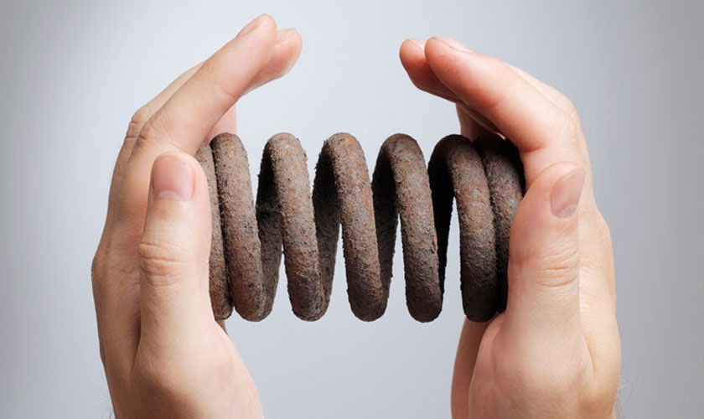
9618 AS
Unit 1
Compression

Slide 265

Class Overview
Advantages & disadvantages of compression
Lossy & lossless compression
Image, audio, video & text compression
Run-length encoding
Huffman coding

Slide 266
Compression
Compression: reducing the size of data
We have mentioned text, images, sound & video – ideally, we want to be able to compress all of these formats
For videos, it’s obvious why we want to compress
Even for text (e.g. web pages – which are HTML/JavaScript/CSS – i.e. text), if we can halve the file size, that means the website will load twice as fast, the website owner will pay half as much for bandwidth, the Internet will be less clogged up etc

Slide 267
Benefits of compression
Can you think of some benefits of compression?
Faster transmission (uploads/downloads/copying)
Saves space on secondary storage (hard drive/SSD)
Can send as an email/file attachment if otherwise too big
Uses less bandwidth – e.g. on a monthly phone contract with 20GB per month
Why don’t we compress everything – e.g. entire hard drive?
Takes time to decompress – e.g. searching files requires entire HDD to be decompressed

Slide 268
Lossy & Lossless Compression
There are 2 categories a compression algorithm/approach can fall into:
Lossy: data is lost – i.e. quality is reduced and can’t be recovered
Lossless: data isn’t lost – i.e. quality stays the same/original can be reconstructed perfectly (but can’t be compressed as much)

Slide 269
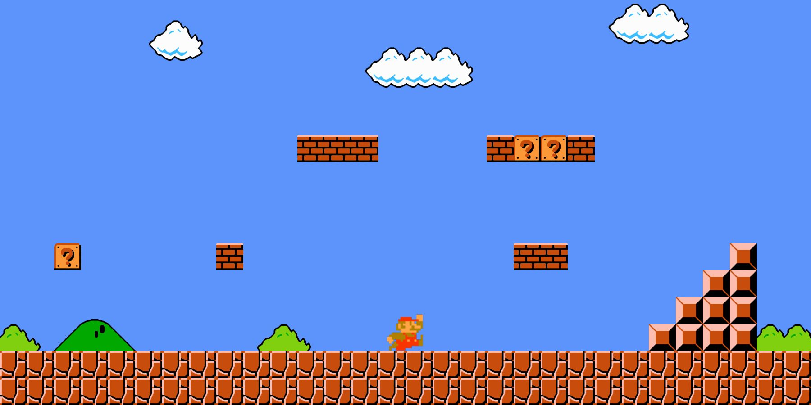
Run-Length Encoding
If you look at this image, could you think of any way we could reduce its file size, without reducing its quality?
There are a lot of repeated colours – rather than storing the colour of each pixel, we can store the number of repeated pixels of that colour, then the colour itself

Slide 270
Run-Length Encoding
The format is:
[number of consecutive cells with same colour] [colour value]
For example, this image may start something like
1000 blue
2 black
10 white
2 black
20 blue etc
Note: colour values would be in binary

Slide 271
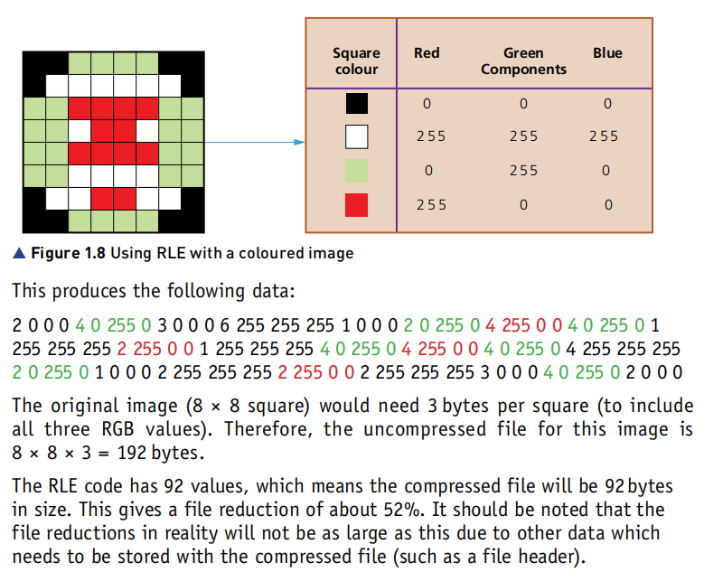

Slide 272
Black & White vs Colour Images
Do you remember how many bits we need per pixel to store a black & white image?
Only 1 – e.g. black = 0; white = 1
For colour, usually 8, 16, 24 or 32 bits would be used per pixel

Slide 273




When does run-length encoding work well?
Here are 4 images – how do you think they would be ordered in terms of file size, from smallest to biggest & why?
1st (32KB)
Horizontal repeats & b&w = good for RLE
4th (593KB)
Colour & low opportunity for RLE
3rd (68KB)
Horizontal repeats = good
Colour = bad
2nd (41KB)
B&W = good
RLE doesn’t work for vertical repeats = bad

Slide 274
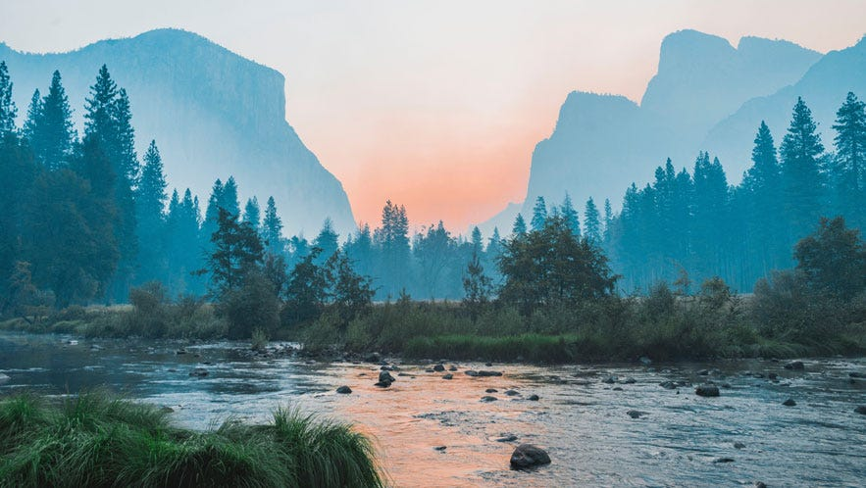
Run-length encoding & photos
Likewise, do you think run-length encoding will work well for photos?
No – since very few consecutive pixels will be identical
e.g. #FFFFFF vs #FFFFFE, while they look the same to us, run-length encoding can’t be used

Slide 275
Run-length encoding & photos
So, with this said, do you think RLE is a lossy or lossless compression technique? (i.e. is some of the original data lost or not?)
It’s lossless – e.g. if we have the RLE sequence 5 red, 10 orange, 3 blue, we can reconstruct the original perfectly

Slide 276
Lossy Image Compression
What was the formula for calculating an image’s filesize?
resolution * colour depth
Hence, how could we reduce the filesize of an image?
By reducing either the resolution or colour (bit) depth of the image

Slide 277
Lossless Audio Compression
Huffman coding – we will look at this later
It was originally developed for text compression – but can also be used for other formats too (since ultimately, all files are just 0’s & 1’s)

Slide 278
Lossy Audio Compression
Removing frequencies & low amplitudes inaudible to human ear – i.e. quiet sounds and very high/low frequencies
Starting with an average amplitude, then storing the differences, rather than the actual value
For example, assume we start at 50db – 50.1 and 49.9 could be represented and +0.1 and -0.1 respectively – this would use fewer bits

Slide 279
Lossy Audio Compression
Again, what is the formula for calculating the file size of an audio file?
sampling rate * sampling resolution * channels * duration
[note: in exam questions, the number of channels will usually be 1]
So we could reduce any, to get a smaller output file
i.e. halving sampling rate = half file size

Slide 280
Lossless Video Compression
Videos are combination of images & audio – so lossless image & audio compression can be used (e.g. RLE & Huffman coding)
Sometimes frame doesn’t change (e.g. white text on black background playing for 10 seconds) – so we can store a frame, then the number of frames it should repeat for
Parts of frame may only change slightly from frame 1 → frame 2 – we can simply store the changes, rather than the whole frame

Slide 281
Lossless Video Compression
“A two hour long 4k UHD movie like you might find on Netflix would be 3400 GB” – yet using lossless compression, it can be shrunk to “about 50GB”
We can compress this even further using lossy video compression, but of course we will lose video quality

Slide 282
Video Lossy Compression
Again, can you remember the formula for calculating a video’s file size?
resolution * bit depth * frame rate * duration
So, again, if we reduce any of the first 3, the file size will decrease
We could also make the video twice as fast to halve the file size, but in most cases, we don’t want to change the video’s duration…

Slide 283
Text Compression
For images, videos & sound, we can use either a lossy or lossless compression approach – do you think this is also true for text?
No – for example, you wouldn’t want to compress “Hello” and the decompressed version comes out as “Hell”
For text, in 99.999% of cases, we want to be able to reconstruct the original exactly – hence we can only use lossless compression methods

Slide 284
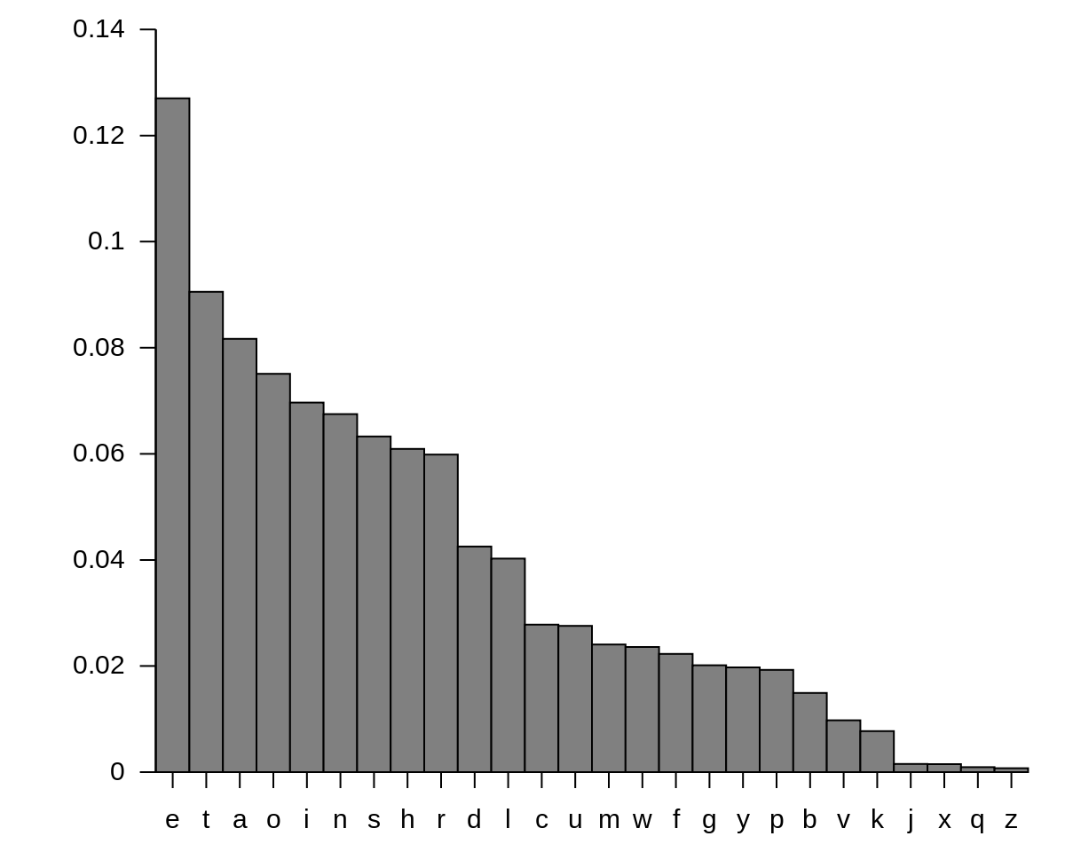
Huffman Coding
Huffman coding takes advantage of the fact that some characters are more common than others
Hence, rather than transmitting data as ASCII/Unicode, we can use shorter codes for the most common characters…and longer codes for the less common ones
All known languages follow this 1/x pattern

Slide 285
Huffman Coding
We will encode/decode our text using Huffman Coding with the following site – you can try your own text too:
https://www.dcode.fr/huffman-tree-compression

Slide 286
Huffman Coding: Encoding
Assume input text “Hello World”
Create frequency table of number of occurrences of each character (case-sensitive)
Assign Huffman codes to letters, with most common letters having shortest Huffman codes
Replace letter with corresponding code
i.e. 11101111101011000000111001010011
Note: the generated Huffman codes are chosen so that there is only 1 possible decoding
char | code
l | 10
o | 110
[space] | 000
W | 001
r | 010
d | 011
H | 1110
e | 1111

Slide 287
Huffman Coding: Encoding
Suppose instead the following codes were chosen
What would 0101 decode to?
It could be “abab”, “abc”, “cc” or “cab”
This is why the generated Huffman codes are clever – since even in a stream of millions of bits, there is only 1 possible decoding
char | code
a | 0
b | 1
c | 01

Slide 288
Huffman Coding: Decoding
Assume input stream of
01100010100111101010001111110010111
Start on the left and find the character each sequence corresponds to
Go to the next bit in the sequence and repeat these two steps, until at the end of the sequence
What was the original string?
lossless text
s | 10
l | 011
o | 000
e | 110
[space] | 001
t | 111
x | 010

Slide 289
Huffman Coding: Uses
Do you think Huffman coding is useful for short strings (e.g. someone’s first name)?
No – since the table also has to be sent & would be bigger than the actual data
For larger, typical text (documents, emails, webpages etc), Huffman encoding can often half the number of bytes

Slide 290
Huffman Coding Example
Generated 100 paragraphs of random words
File size was 80KB
Was compressed to 40KB with Huffman coding
So in this case, we got a 50% compression ratio
Can test with tools like https://craftyspace.net/huffman/ or https://www.dcode.fr/huffman-tree-compression

Slide 291
Huffman Coding Example
Which of these inputs do you think could be compressed the most? (all are 26 characters)
abcdefghijklmnopqrstuvwxyz
aaaaaaaaaaaaaaaaaaaaaaaaa
🦇🐺🐗🐴🦄🐝🪱🐛🦋🐌🐞🐜🪰🪲🪳🦟🦗🕷🕸🦂🐢🐍🦎🦖🦕🐙
26bytes to 48 ~2x increase
26 bytes to 6 bytes ~4x decrease
156 to 107 bytes ~1.5x decrease

Slide 292
Questions
Why did the emojis take up more bytes initially?
Since they can’t be stored in ASCII (7 or 8 bits) – Unicode (UTF-8; 8-32 bits) is required
Why was “aaa…aaa” able to be compressed the most?
As every character was the same, they could be stored using a short Huffman code – there would be no characters with longer Huffman codes

Slide 293
Questions
What would happen to the compression ratio if we had longer text – e.g. we used the same set of 26 emojis, but had a text with 1000s of characters?
It would improve – i.e. longer text = more repeats = better compression
The initial overhead of storing the Huffman table is overtaken by the amount of compression we get

Slide 294
Questions
Suppose you had 2 strings:
“aaabbb”
“ababab”
How would their compression ratio compare?
It’d be the same – run-length encoding isn’t used for text, since in regular text you’d rarely have long sequences of identical characters (and overhead of storing counts would make file size increase)

Slide 295
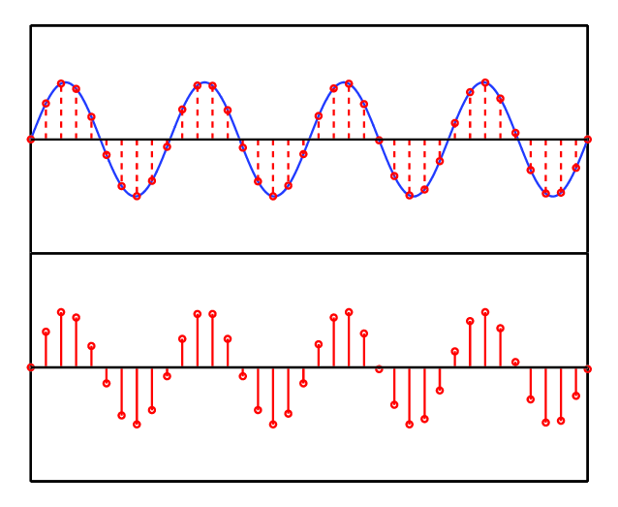
Huffman Coding for Audio
Note: Huffman coding can also be used for audio – this is because some amplitudes will appear repeatedly

Slide 296
Extension Task
Use a hex editor like HxD to find the username/password for crackme.exe – change the username to “ABCDE” and the password to “1234”
Tip: run the crackme.exe, type in a random password – the string in the error message is near to the username & password in the code – you can use CTRL + F to search for it in HxD

Slide 297
List lossy and lossless compression methods for text, images and audio:
Text: Huffman Coding, Run-Length Encoding
Images: reduce resolution, bit/colour depth, run-length encoding
Audio: reduce sampling rate/frequency/resolution/channels, remove inaudible amplitudes/frequencies, Huffman Coding

Slide 298
Explain how run-length encoding works:
The number of consecutive pixels of the same colour are counted – rather than storing repeated pixels redundantly, data will be stored in the form [count][colour] e.g. 3 0 255 0 4 255 0 0 to represent 3 green, then 4 red pixels
Explain how Huffman Coding works:
A table mapping data to Huffman codes of the input data (e.g. text) is created and sent with the data – the most common values are given the shortest Huffman codes. The codes are generated using Huffman trees, so that there is only one possible decoding

